Slide 1
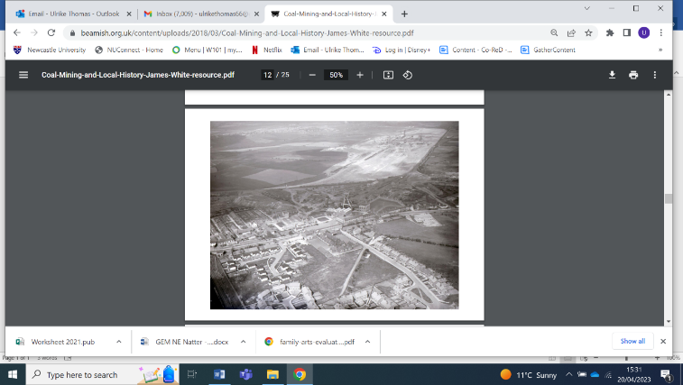
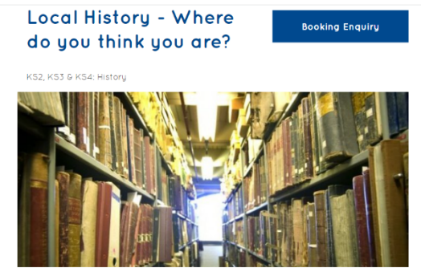
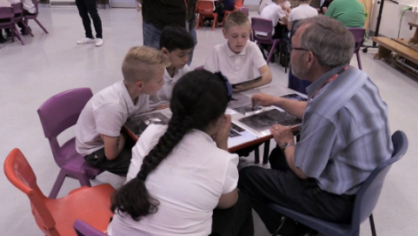
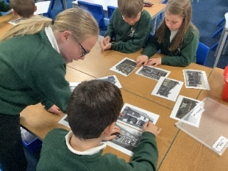
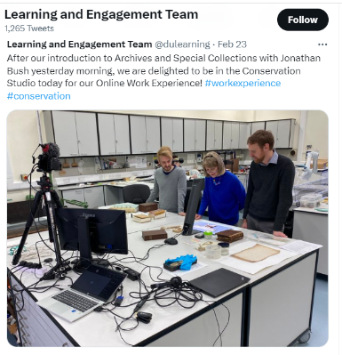
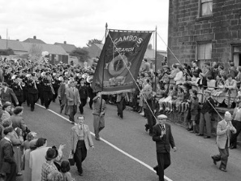
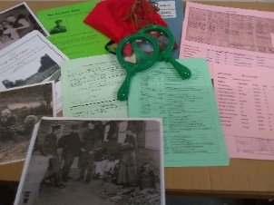
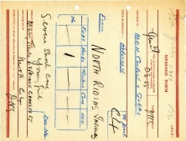
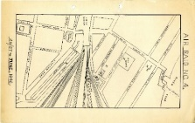

Learning Arc
Networks for Change Research
January –December 2023
Ulrike Thomas

Slide 2
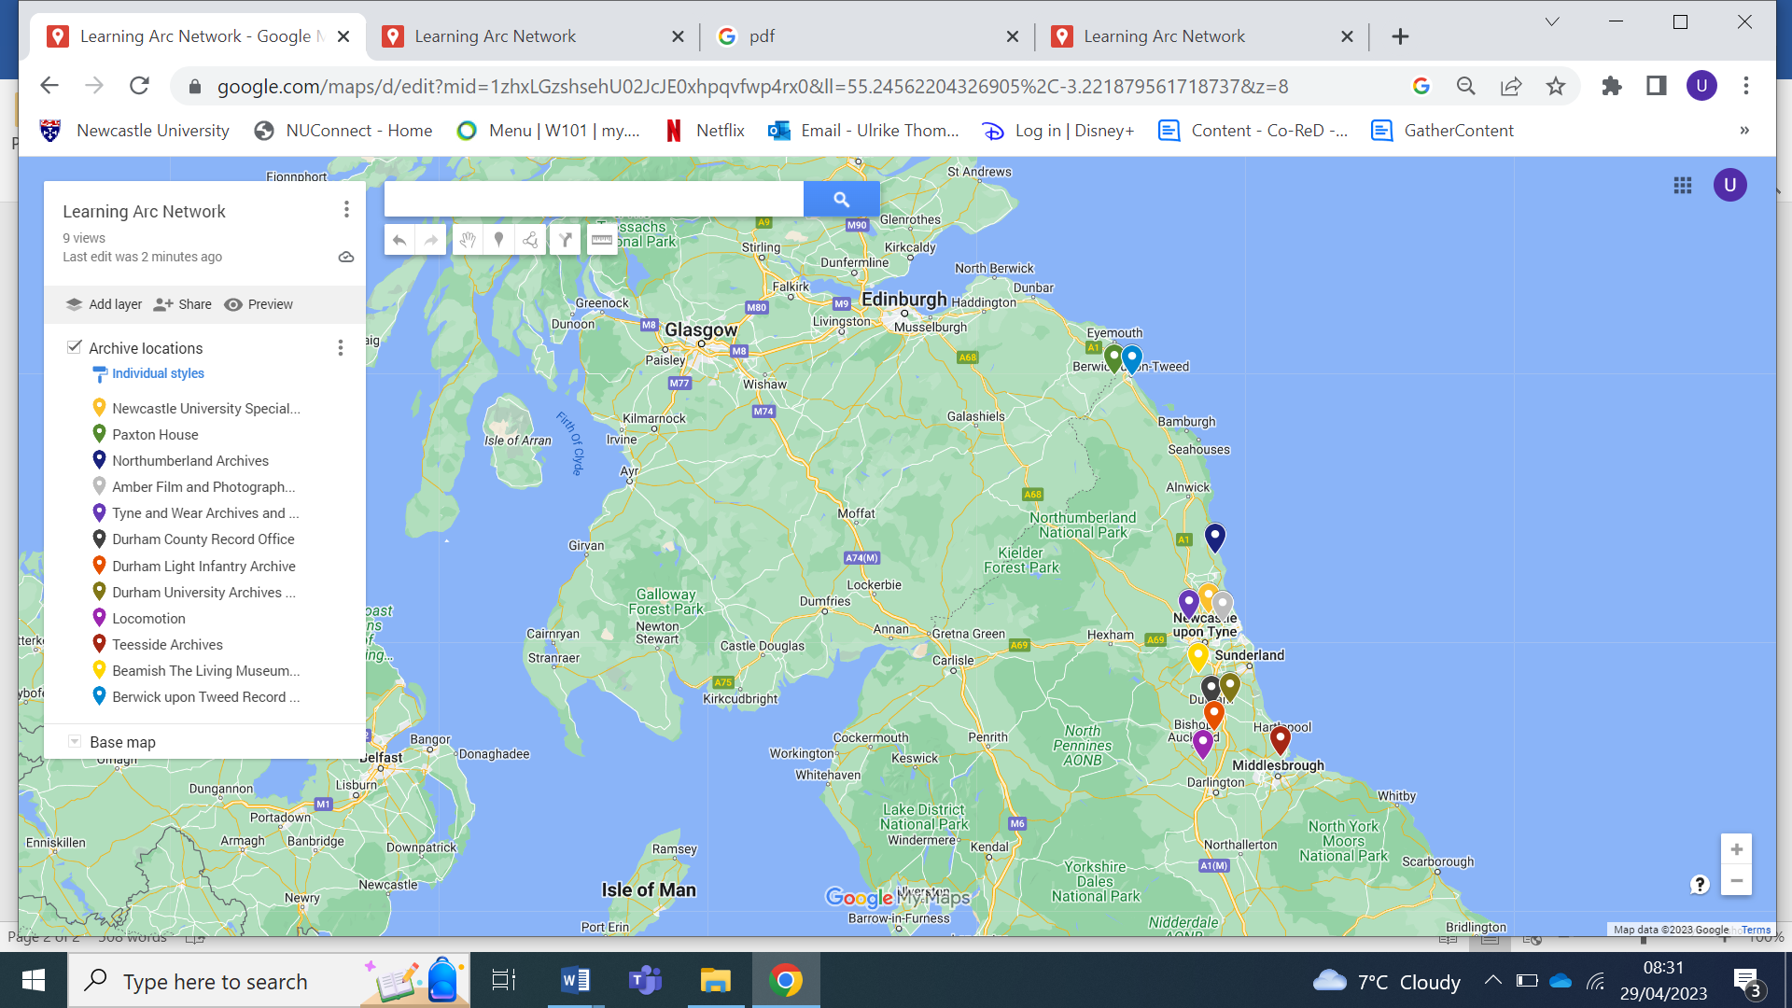
Research Aims
To enable the membership to understand the structure and role of the Learning Arc network and the complexities of the individual archive organisations within it,
To enable the membership to fully understand the network’s education offer (individual archives and as a collective)
To enable the membership to explore the benefits of being part of the network as well as the challenges faced,
To enable the membership to understand how archive learning professionals can best support the needs of schools and educators (post pandemic),
To propose ideas and ways forward for the future of the network.

Slide 3
Phase 1:
Learning Arc

Slide 4
Being part of Learning Arc
Phase 1
Data collection | In depth interviews with a representative from each archive. Visits to each archive. Analysis of documentation including reports, feedback, evaluations, attendance data. Exploration of the web presence.

Slide 5
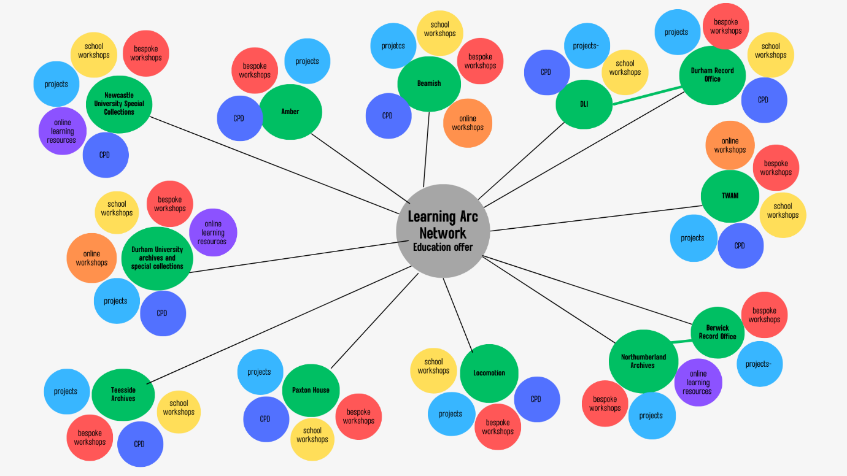
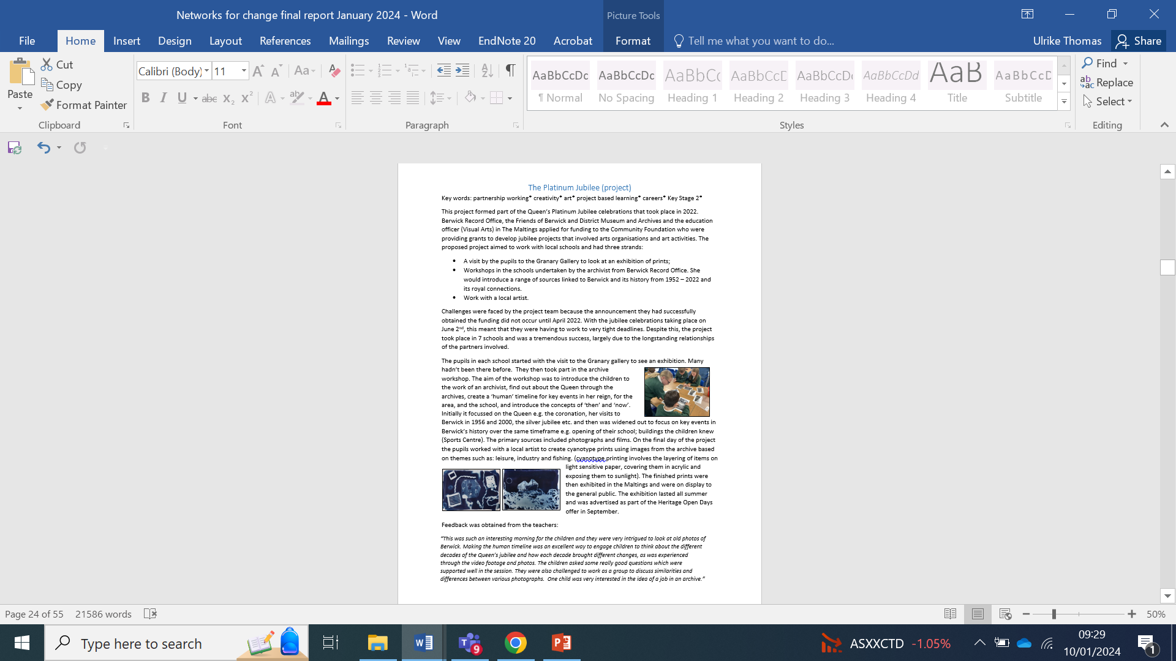
Learning Arc membership and the education offer
The report contains:
A description of the history of Learning Arc
Individual descriptions of each archive, their general scope of work and then a focus on the education offer
One case study per archive that best exemplifies the education offer
A diagrammatic summary of the collective offer demonstrating the scope and complexity of the network
Exemplification of the impacts on teachers and pupils based on evaluation reports
Discussion of the barriers faced by LA when engaging with schools
The benefits of being part of the network and suggestions for improvement.

Slide 6
The impacts of working with archives on students and teachers:
Impacts: students
Increased familiarity with the local area – the history, places and cultural offer; Development of cultural capital; Development of social capital- careers, study pathways; Increased engagement; Improved behaviour; Increased confidence; Enjoyment; Pride in work; Shift in attitude towards other people and the area they live in; Skill development- primary source analysis, photography, writing, team work etc.; Valued seeing documents etc. related to real lives and events and to their work in school: Understanding of, and interest in, archives; Development of enquiry, debating, reasoning
Impacts: Teachers
Increased familiarity with the local area –the history and cultural offer ‘a sense of place’; Skill development – using archives, historical analysis, the creative activities Improved confidence; Increased motivation; Understanding of how to embed archives and skills into the curriculum; A better understanding of how to draw on local history to exemplify National Curriculum subjects; Appreciation of expertise in the classroom that the teacher can learn from; Ability of archives to enable children to explore and understand difficult concepts and sensitive subjects e.g. then and now with young children, slavery; Seeing their pupils in a new way

Slide 7
The benefits of being part of the network
The opportunity to share practice. Despite differing agendas and sometimes audiences, knowledge and ideas are shared that can be adapted to each archive.
The network is considered important because it is made up of people working in the same sector and for whom there are few specific archive education professional development opportunities. The network meetings therefore provide them with the opportunity to connect with others in the same field.
The stability of the network and the fact that it has had representation from the same organisations (with some additions) since its inception, is also considered a strength.
Throughout the years partnership working between the archive members has taken place with the intention to undertake cross collection working, draw on each other’s strengths and trial innovative ways of working.

Slide 8
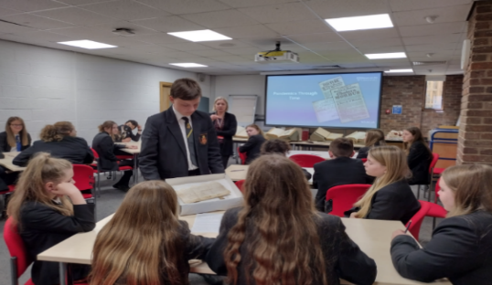
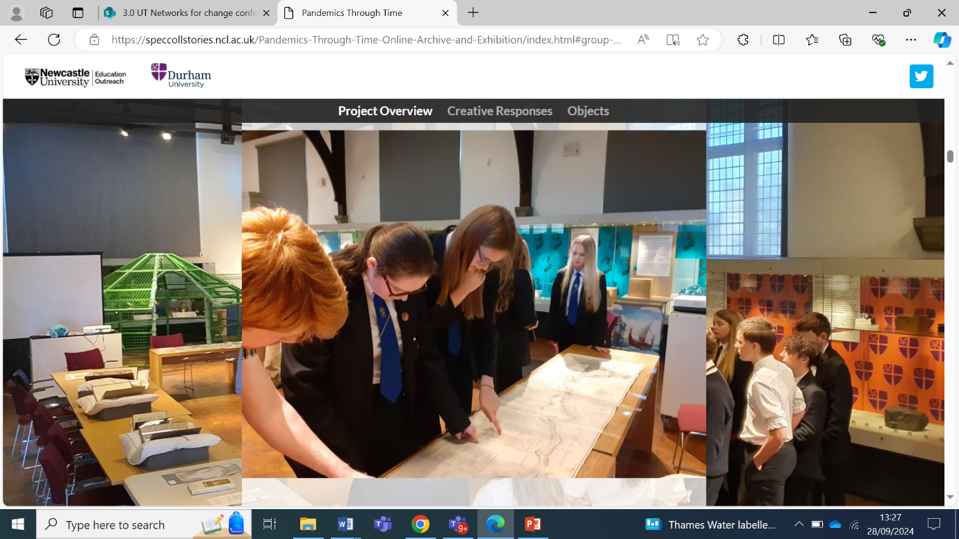
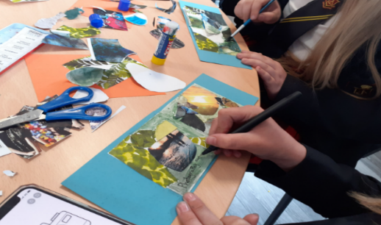

Learning Arc: working together
Pandemics through Time
Collaboratively planned by the Education Outreach Team at Newcastle University Library and the Learning and Engagement Team at Durham University.
Aims:
To introduce students to archival collections across both universities. Both universities hold relevant collections that represent (inter)national pandemics in a local context e.g. Cholera (Newcastle) and the Plague (Durham).
To provide students with an introduction to university life in two very different universities.
To introduce the students to a range of careers.
To produce an online archive made up of watercolour paintings inspired by their experience of lockdowns

Slide 9
Phase 2:
Teacher consultation

Slide 10
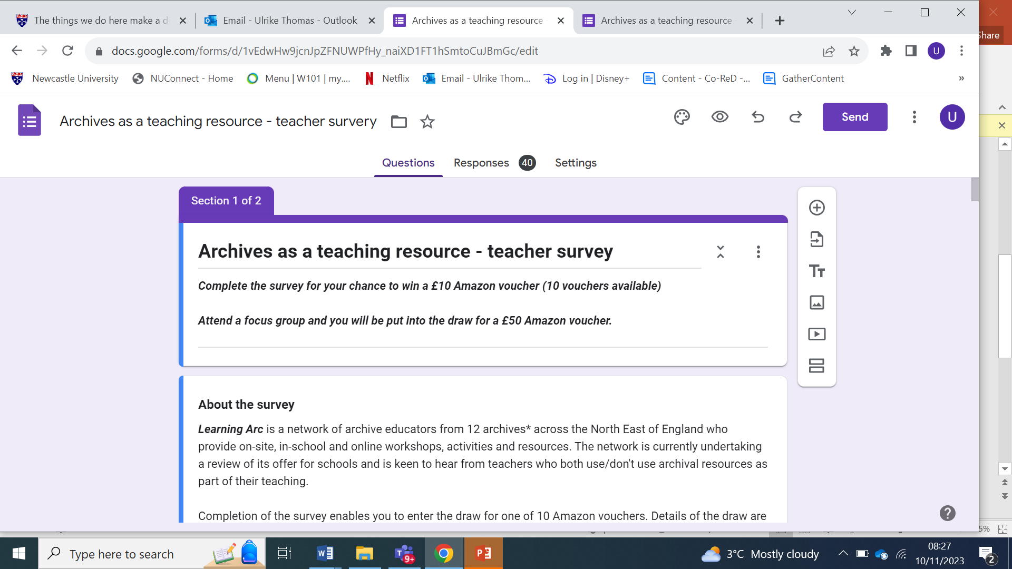

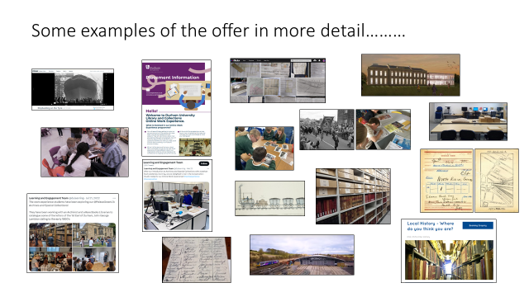
Teacher consultation: methods
Online survey
Vouchers were offered to encourage teachers to complete the survey
The survey was open for three weeks
40 participants completed the survey
10 vouchers
Interviews
1 in-person,
3 online
These took 45-60 minutes
A total of 7 participants
Voucher to all 7

Slide 11
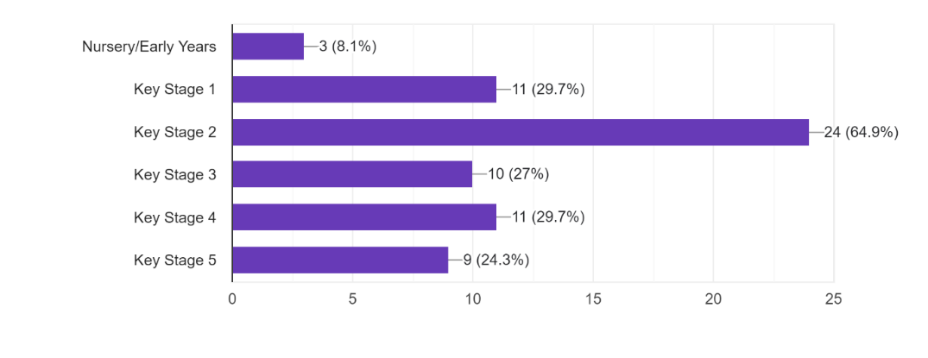
Findings:
Do they use archival resources?
What had they used and why?
Census data (8 mentions), old photographs (10 mentions) , maps (5 mentions) Letters , Oral histories, diaries, travel documents, household accounts and death certificates.
In terms of how the sources were used these were predominantly curriculum focussed with reference made to local history (the school, local area) , Victorians, architecture, then and now, WW1, the Holocaust, WW2, GSCE, EPQ, Geography, English, celebrations e.g. Queen’s jubilee.

Slide 12
Examples:
Individual stories from the Holocaust for KS3 - using diaries, original travel documents and photographs. Hyperinflation in Germany taught using archived household accounts. Local History of WWI using CWG records to tell the stories of local enlisted men.
We have used census data when looking at individuals and families on our history topics e.g. The Bradford Brothers of Witton Park and William Towers in our Victorians unit. In EYFS we looked at old photographs from mining days. This links into our KS1 topic of Norman Cornish and our subsequent mining topic in Year 3.
Census data to show population growth in industrial towns, WW1 soldier death certificate and records to show how historians can make statements such as % of soldiers that died from gas attacks. WW1 letter to show medical evacuation route.
Old OS maps and aerial photos to compare then and now. Compare human and physical geographical changes. Archive photos to infer information about situations, buildings and characters of the past in the locality.

Slide 13
The value of archives:
Survey respondents:
92.5 % agreed with the statement ‘I think using archival records can enhance pupil learning’.
87.5% agreed with the statement ‘ I think a visit to an archive can enhance pupil learning.’
90% agreed with the statement ‘ I think a visit to an archive can devlop social/cultural capital.’
However….
33% didn’t know where there are local archives that offer workshops and resources
43% didn’t know how to get in touch

Slide 14
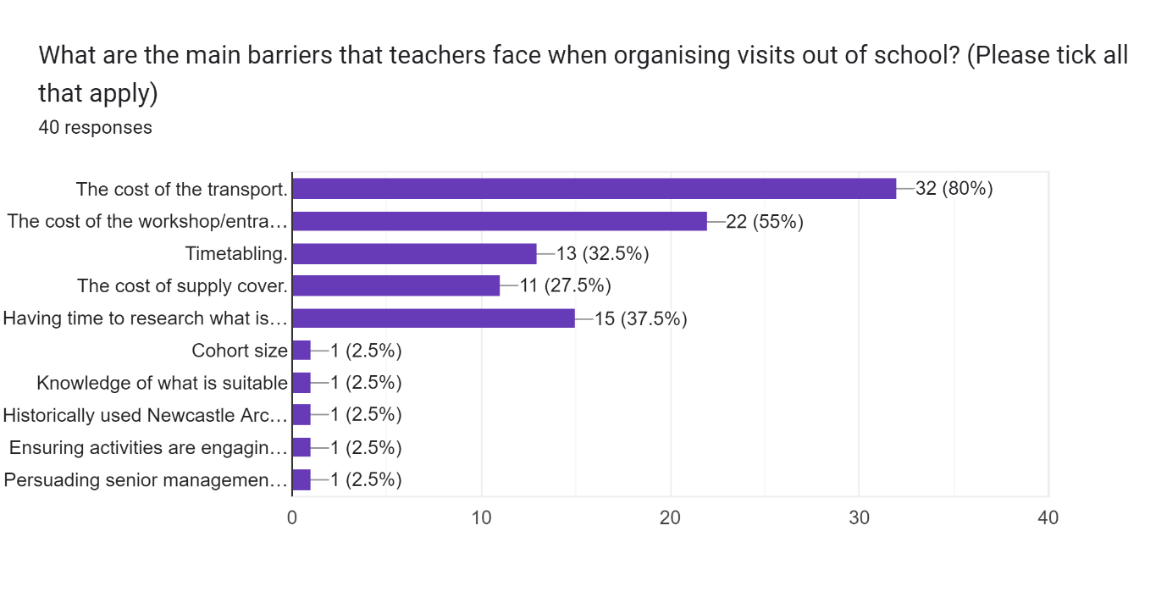
Barriers faced by teachers when organising visits
Most significant?
Costs relating to: transport, supply cover, workshop/entrance fees
Timetabling
Having time to research what is available/time to organise the visit

Slide 15
Getting permission to take pupils out of school is very difficult and it there is a huge workload issue in relation to organising even a small trip.
SLT will also want to know: what are the students going to experience that they wouldn’t experience in school? Is it going to be exciting and memorable? Value for money e.g. several things on one day. Secondary: What else will the students miss? What else will the teacher be missing i.e. what are the cover implications? Is it worth the risk assessment?
Transport costs have spiralled in the past few years.

Slide 16
CPD
There was a lot of interest in attending CPD
Increasingly rare to get out
Twilights preferable
Potential for a sequence of sessions over one or two terms (One 45 minute session per half term)
Primary – have more flexibility but also have more time in the summer term.
Secondary- after exams as they have more time but they are also planning next year’s visits etc.

Slide 17
How to get the teachers’ attention
The importance of a mutimodal approach:
Email from the archives and other partners e.g. North Tyneside Learning Trust, Historic England. History co-ordinators will send round anything they find useful to other staff.
Twitter/X
To get attention make a very specific link to the syllabus/ curriculum objectives
Search Engine Optimisation- tags
Be ‘relentless’
Attend Network meetings
‘Calling all KS4 History teachers: A useful resource for GCSE paper 1 ‘Conflict and Tension’

Slide 18
Phase 3
Ideas for the future of the network

Slide 19
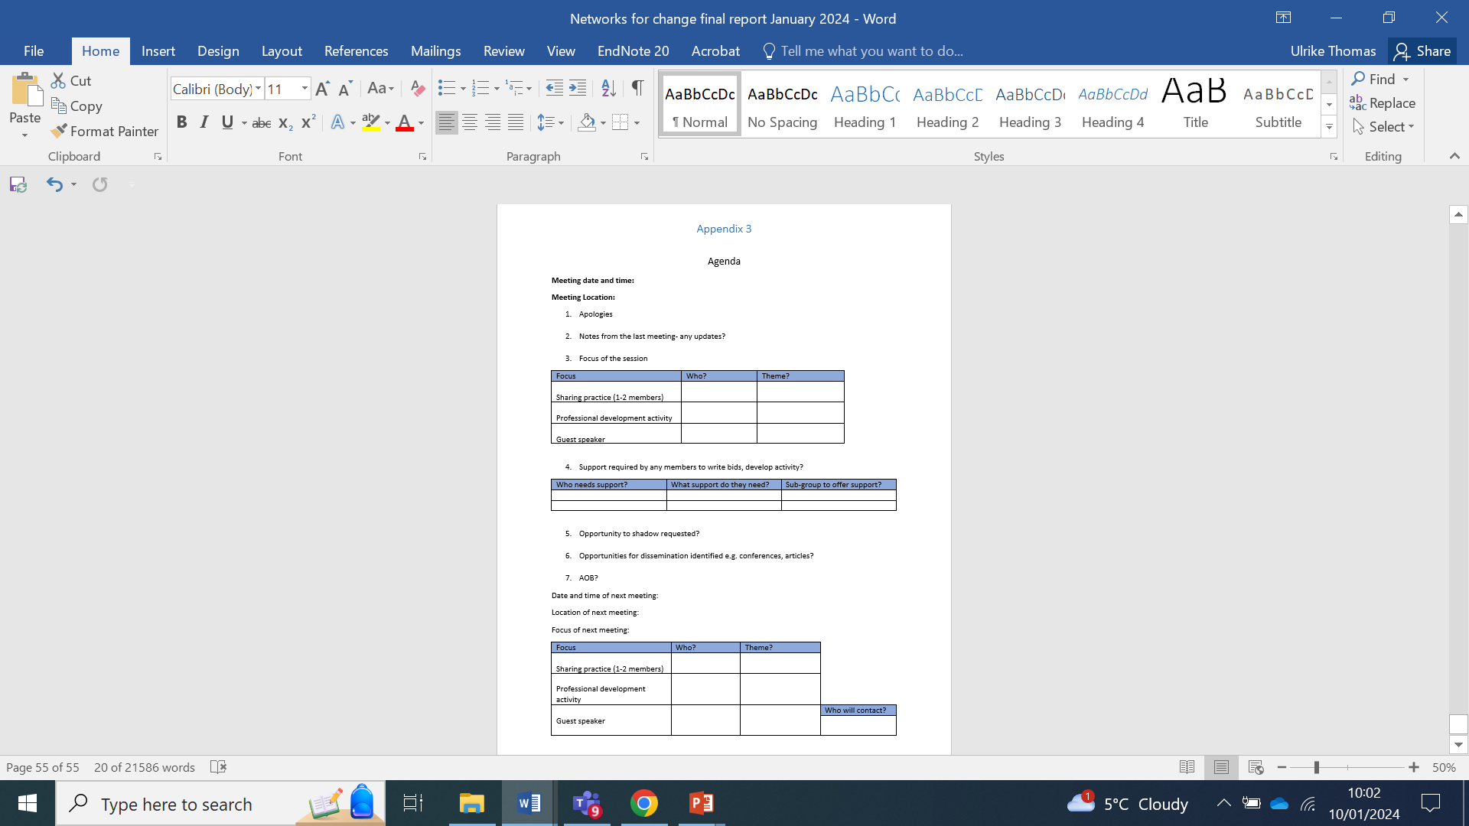
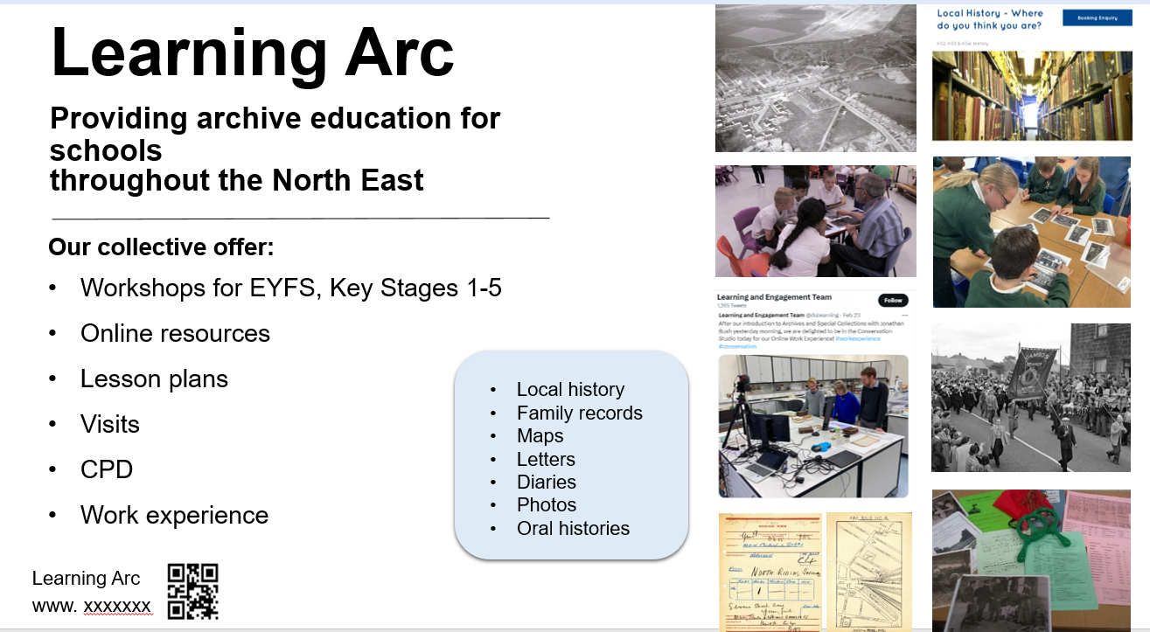
Strengthening the network
Meetings:
Timing and structure
Content of the meetings- practice sharing and Professional Development including guest speakers
Support and shadowing opportunities
More opportunities to work together, apply for funding
CPD offer for teachers
Advertising
Dissemination of good practice

