Slide 1
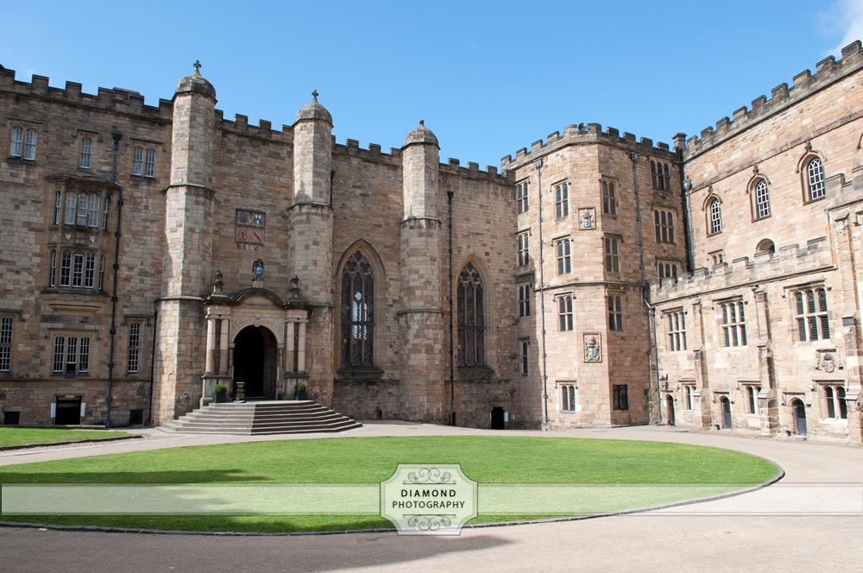

Durham Castle Quiz!

Slide 2

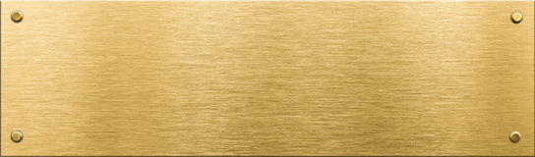


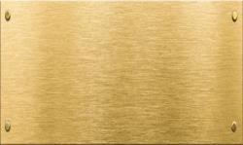
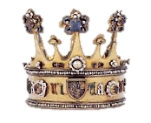

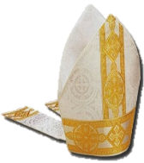

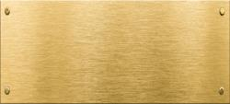
1. Which really important person lived in Durham Castle hundreds of years ago?
b. The Prince Bishop of Durham
a. The king
c. Your head teacher

Slide 3
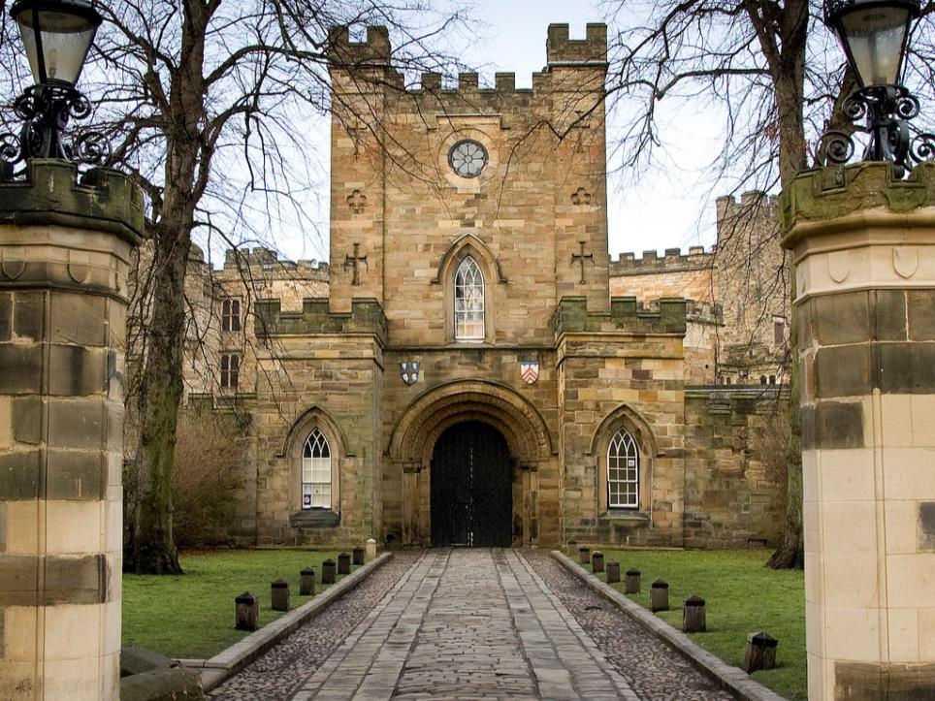

2. When you are standing here, what’s missing that normally goes around a castle?
a. The wall
c. The moat
b. The front gate

Slide 4
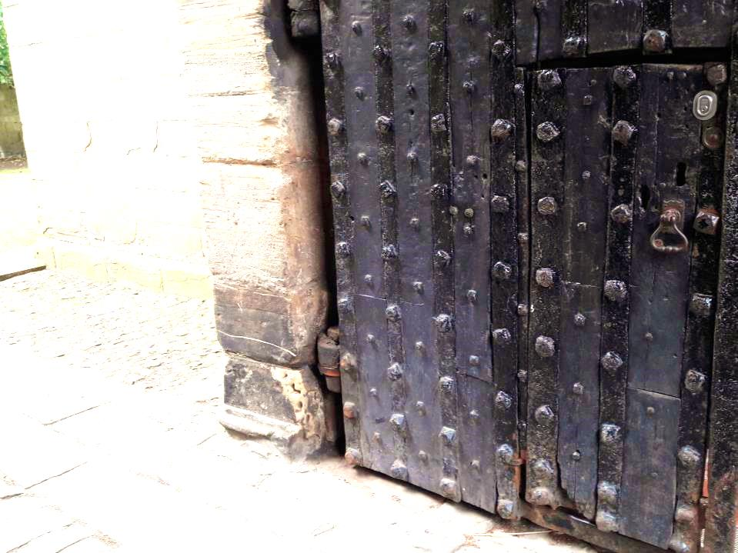
3. Why does Durham Castle’s front gate have a little door in it?
a. So people can get in without opening the big heavy doors
b. Because people were shorter long ago
c. To let children but no adults in.

Slide 5
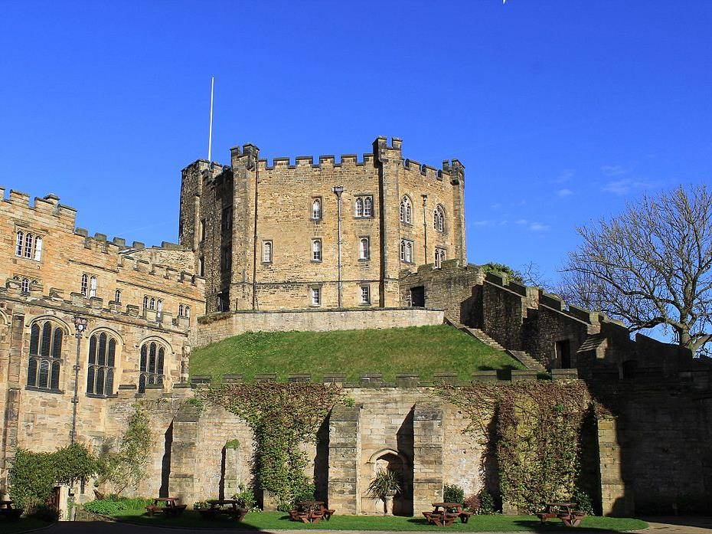
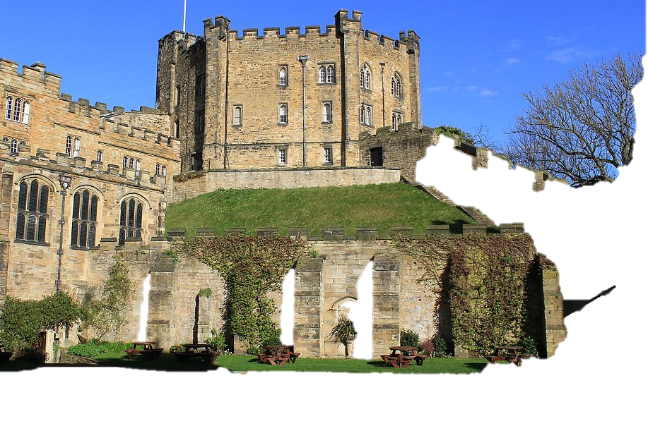




a. So you can see for miles around
b. To make it hard for enemies to attack
c. Both of these
4. Why is the keep high up on a hill?

Slide 6
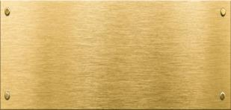




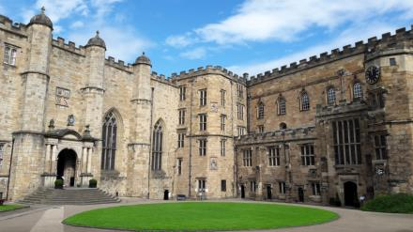
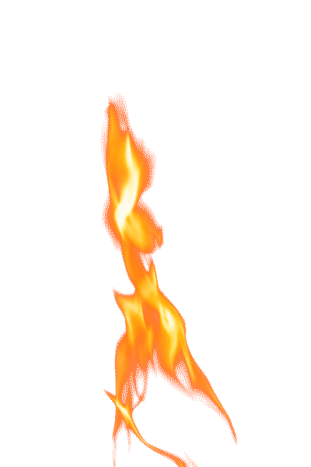
5. When they first built it, why was the kitchen separate from the Castle?
a. To keep all the smells away from the Castle
Kitchen
Castle
b. So the whole Castle wouldn’t burn down if there was a fire
c. So the food could cool down when it was taken outside

Slide 7
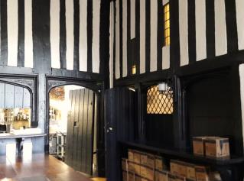
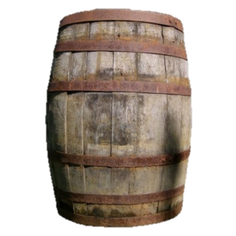
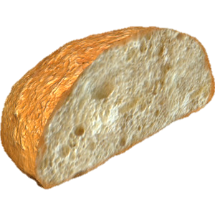
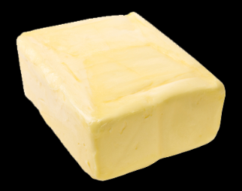

6. What goes in the buttery?
a.
C. BEER
b. Bread
Butter

Slide 8
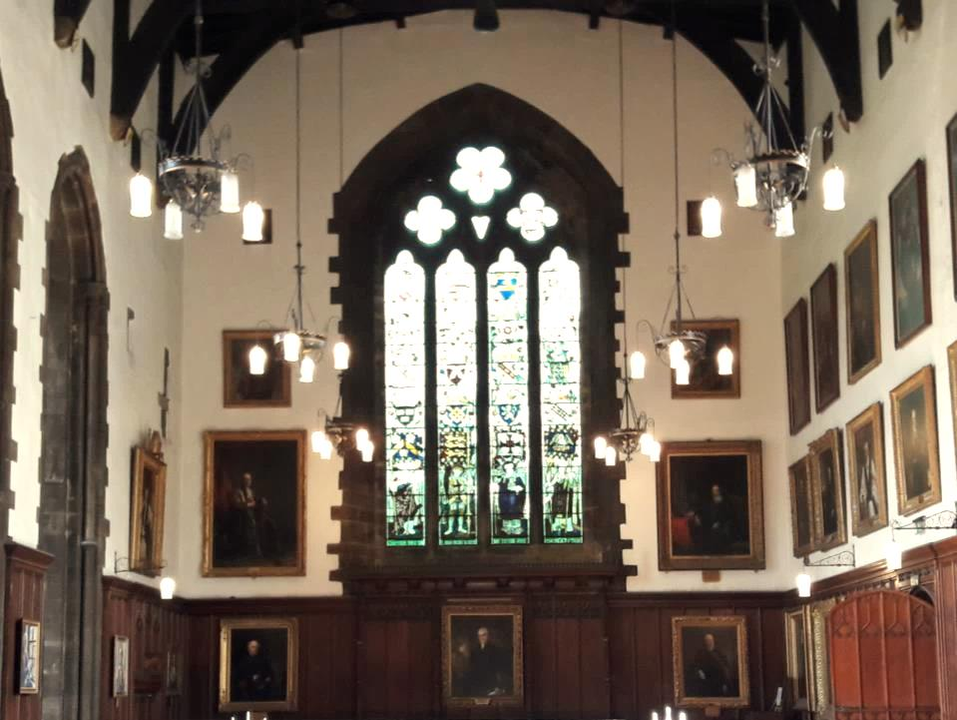

7. What was the Great Hall used for?
a. To have your meals with everybody
b. To practice fighting in
c. To play football in

Slide 9
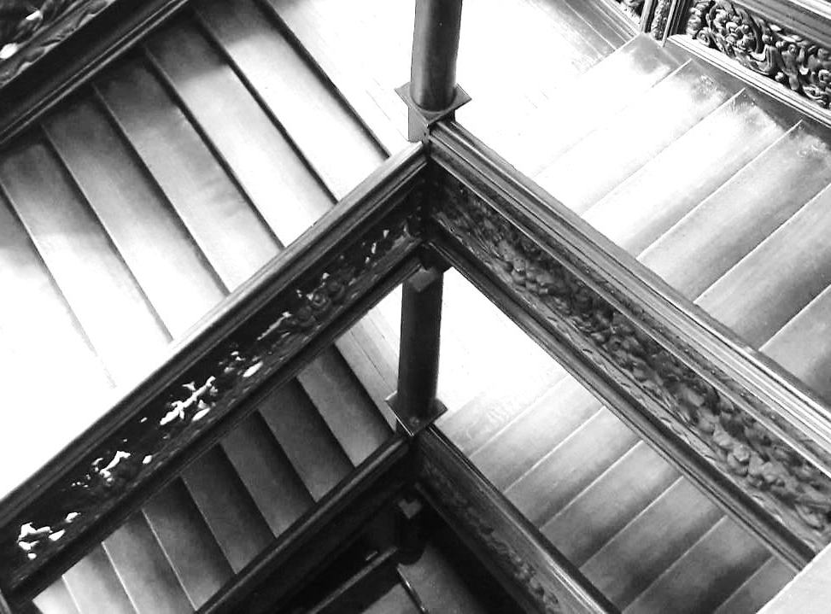
8. What is strange about the Black Staircase?
a. It’s white
b. It’s really old
c. It’s wonky

Slide 10
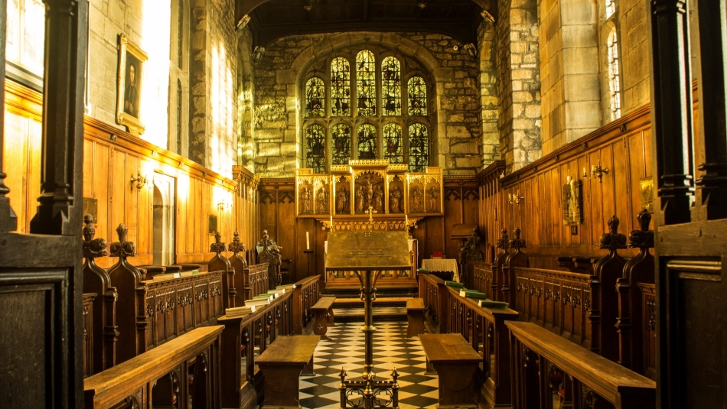
a. To make people miserable
b. To have a sneaky sit down during long church services
c. To play music with
9. What are misericords used for?

Slide 11
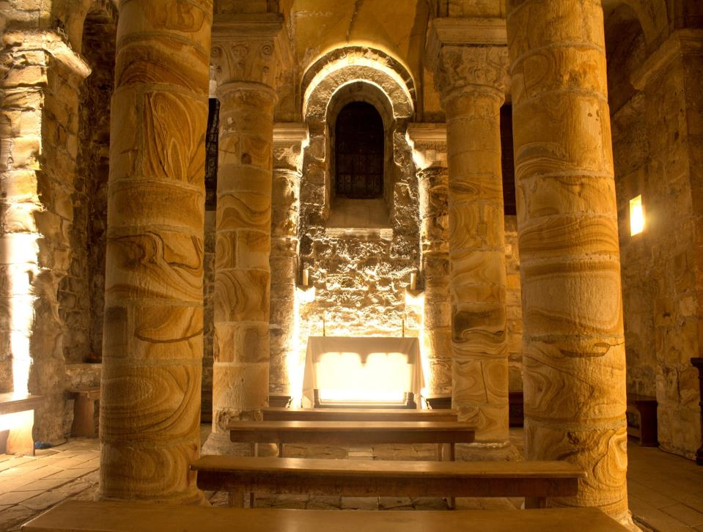
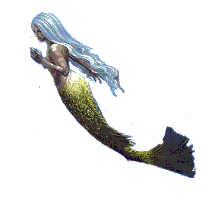
10. TRUE OR FALSE - the Norman Chapel has a mermaid in it.

Slide 12
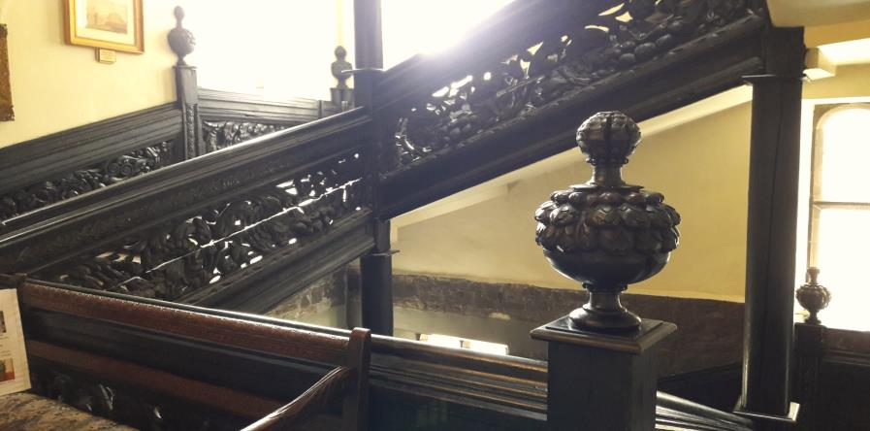

BONUS QUESTION:
What fruit could you find on the Black Staircase that showed how rich you are?

Slide 13
Answers!

Slide 14
1. Which really important person lived in Durham Castle hundreds of years ago?
b. The Prince Bishop of Durham
a. The king
c. Your head teacher

Slide 15
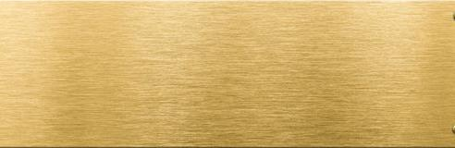
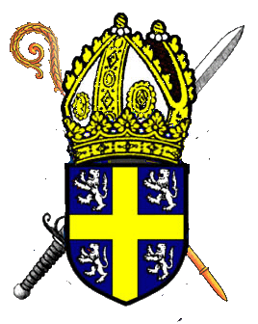
b. The Prince Bishop of Durham – this person would be in charge of Durham Cathedral (and all of the churches in the area), as well as things like money, taxes, courts, armies, etc.

Slide 16
2. When you are standing here, what’s missing that normally goes around a castle?
a. The wall
c. The moat
b. The front gate

Slide 17
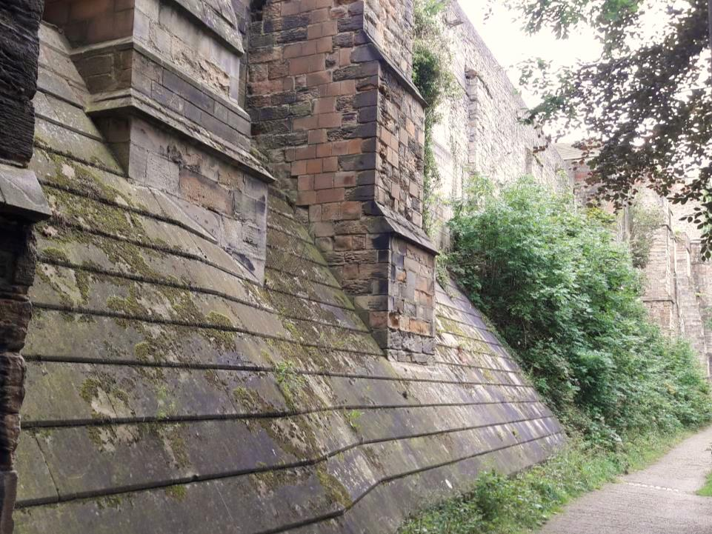



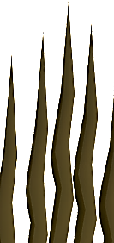

c. The moat – it got filled in about 350 years ago, when it wasn’t needed any more. The moat wasn’t filled with water – it had sharp metal spikes in the bottom!

Slide 18
3. Why does Durham Castle’s front gate have a little door in it?
a. So people can get in without opening the big heavy doors
b. Because people were shorter long ago
c. To let children but no adults in.

Slide 19
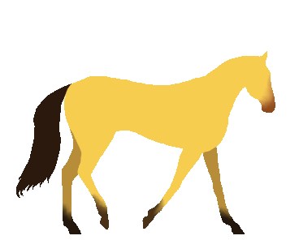
a. So people can get in without opening the big heavy doors – at least, less important people. Rich people would ride in on horseback so they needed big tall gates.

Slide 20
a. So you can see for miles around
b. To make it hard for enemies to attack
c. Both of these
4. Why is the keep high up on a hill?

Slide 21
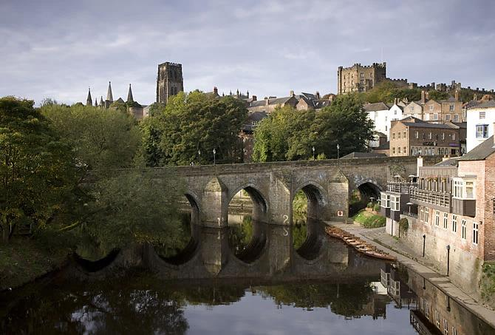

c. Both of these
– Being on a hill not only makes it harder to attack it also means that you can spot your enemies early, and get ready to defend yourself!

Slide 22
5. When they first built it, why was the kitchen separate from the Castle?
a. To keep all the smells away from the Castle
Kitchen
Castle
b. So the whole Castle wouldn’t burn down if there was a fire
c. So the food could cool down when it was taken outside

Slide 23
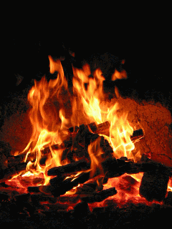
b. So the whole Castle wouldn’t burn down if there was a fire – These kitchens would have cooked with fire, so there’s a bit of a fire risk of course. If your kitchen burns down, you can rebuild it easily enough – not so with the Castle!

Slide 24
6. What goes in the buttery?
a.
C. BEER
b. Bread
Butter

Slide 25
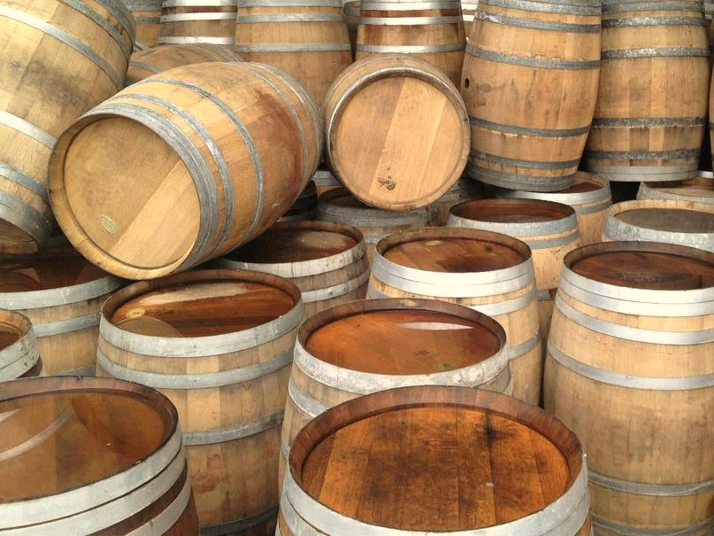
c. Beer – NOT butter!
The name comes from the large barrels they would keep beer in, called ‘butts’ (like a water butt).

Slide 26
7. What was the Great Hall used for?
a. To have your meals with everybody
b. To practice fighting in
c. To play football in

Slide 27
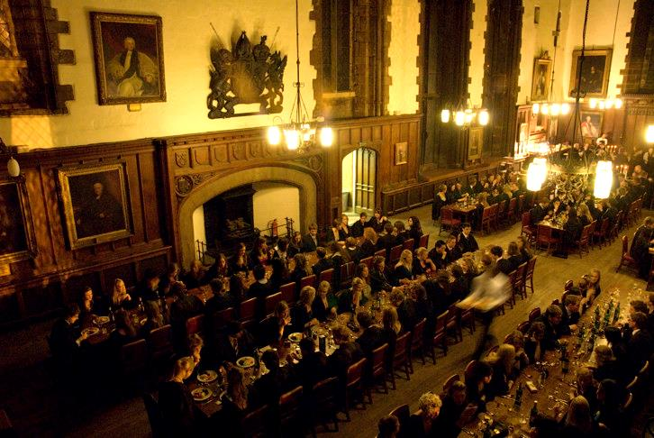
To have your meals with everybody
– very important, as it’s a great way to show off how rich you are! You also need to feed all of the people who run Durham for you, and all of your soldiers.

Slide 28
8. What is strange about the Black Staircase?
a. It’s white
b. It’s really old
c. It’s wonky

Slide 29
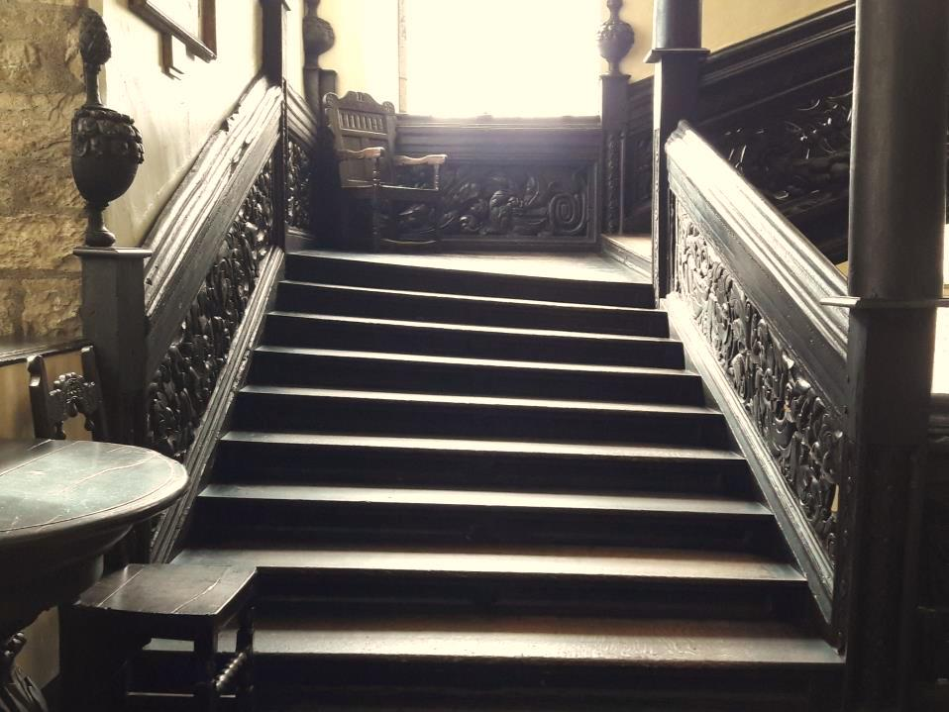
c. The stairs are wonky – they were originally built straight, but as a ‘floating staircase’, it had no supports. Of course, the stairs began to lean in over the years, so supports had to be put in.

Slide 30
a. To make people miserable
b. To have a sneaky sit down during long church services
c. To play music with
9. What are misericords used for?

Slide 31
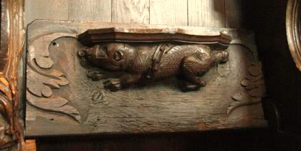
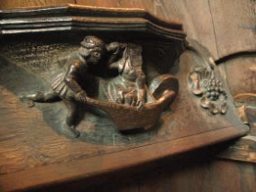
b. To have a sneaky sit down long church services –
you wouldn’t be allowed to sit down in church unless the priest said so, so you could have a misericord – a seat with a special ledge, so when the seat is folded up, you can still sit down. There’s not many left nowadays, so the ones at Durham Castle are quite important.

Slide 32
10. TRUE OR FALSE - the Norman Chapel has a mermaid in it.

Slide 33
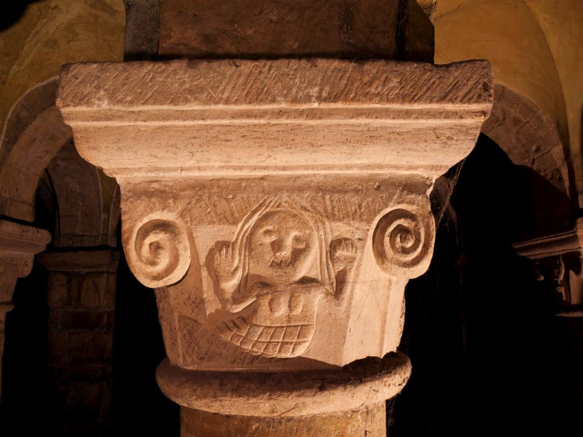
TRUE – at the top of the pillars in the Norman Chapel there are lots of faces, plants, animals, scenes from stories, and a mermaid – possibly the oldest carving of a mermaid in England!

Slide 34
BONUS QUESTION:
What fruit could you find on the Black Staircase that showed how rich you are?

Slide 35

Pineapples.
In the 17th century, they were enormously expensive – one would cost the equivalent of roughly just over £6,000! They had to be exported from South America, and when they were first brought back, rich people across Europe immediately started trying to grow them, eat them and decorate with them.

Slide 36
Well done!

