Slide 1


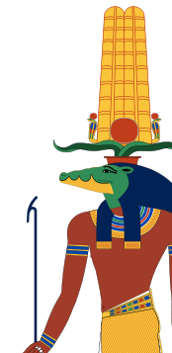
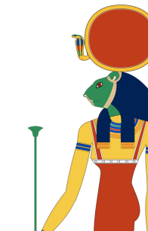
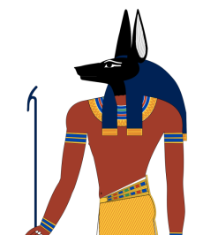
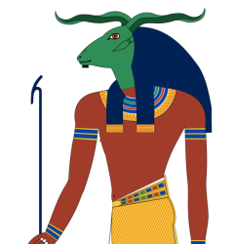
Durham University Oriental Museum Ancient Egyptian Quiz!
Ready?

Slide 2

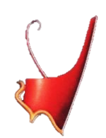
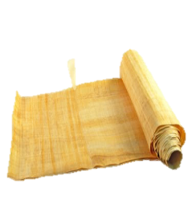
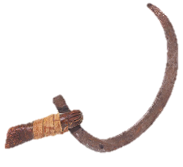
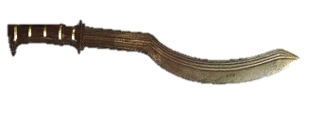

1. What was a shabti figure?
a.
A
soldier
for the afterlife
b.
A
servant
for the afterlife
c.
A
scribe
for the afterlife
d.
A
king
for the afterlife

Slide 3
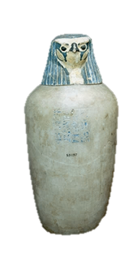
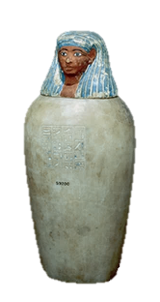
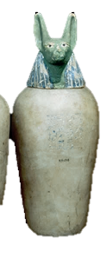
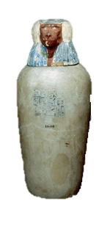
2. What is the name of the jar that organs would be preserved in during mummification?
a.
Body
jar
b.
Round
jar
c.
Canopic jar
d.
Anubis
jar

Slide 4

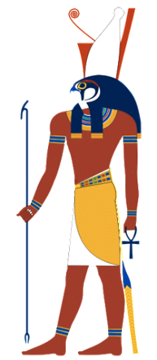
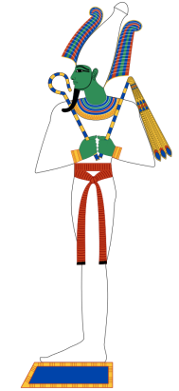
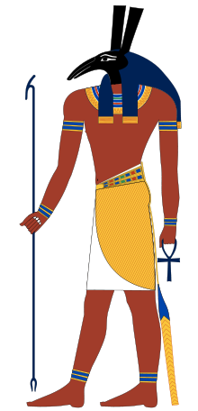
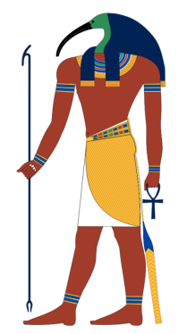
3. The ‘wedjat’ eye symbol is said to be the eye of which god?
a.
Osiris
b.
Seth
c.
Thoth
d.
Horus

Slide 5
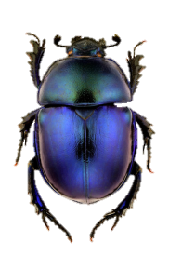
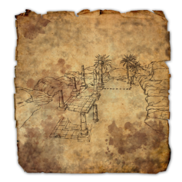
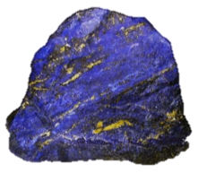



4. Why was dark blue jewellery so expensive in Ancient Egypt?
a.
It was made from lapis lazuli, which came from far outside Egypt
b.
It was made from a rock that was too hard to carve
c.
It was made from lots of crushed up beetles
d.
It was made from plants from far outside Egypt
X

Slide 6
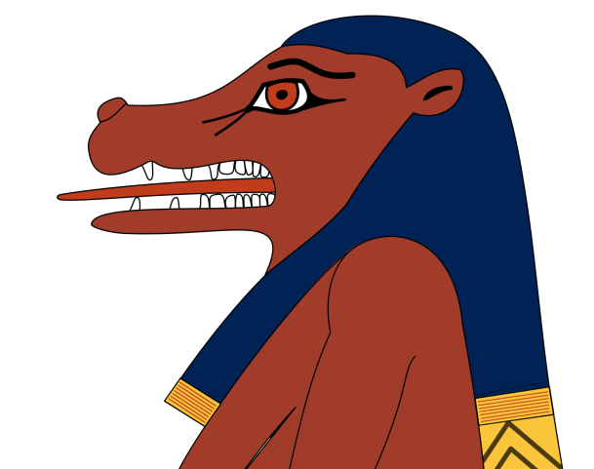
5. Name the animals that the goddess of mothers and babies, Tarawet, was made up of
(three answers)

Slide 7
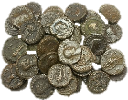
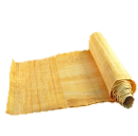
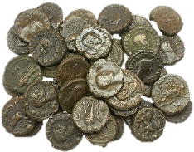

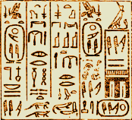
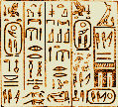
6. Why was becoming a scribe so hard?
a.
It was very expensive to learn how to write
b.
Scribal school
was very tough
c.
There were over 1,000 different hieroglyphic symbols to learn
d.
All of the above

Slide 8
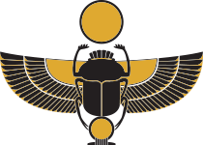
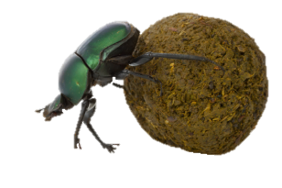
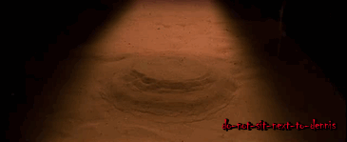
7. Why did the Ancient Egyptians often put scarab beetle amulets with mummies?
a.
They looked pretty
b.
They would keep the mummified person safe
c.
They would eat up all of the dung in the afterlife
d.
They would eat up any intruders in the tomb

Slide 9
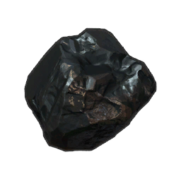
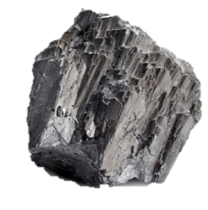
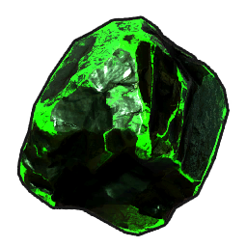
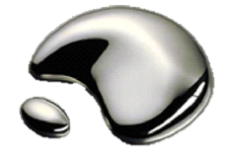
8. What poisonous ingredient could be found in Ancient Egyptian eye makeup?
a.
Lead
b.
Arsenic
c.
Mercury
d.
Plutonium

Slide 10
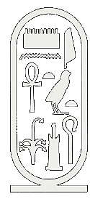
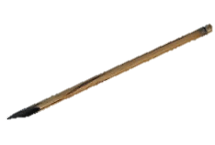
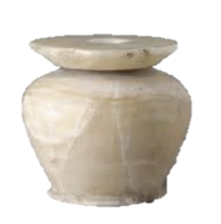
9. What was a cartouche?
a.
A
pen
b.
A weapon
c.
A
circle to keep your name safe
d.
A
make up pot

Slide 11
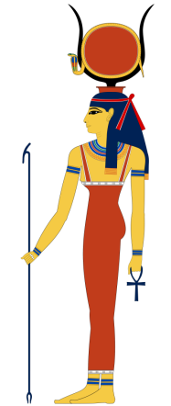
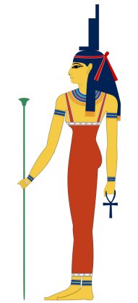
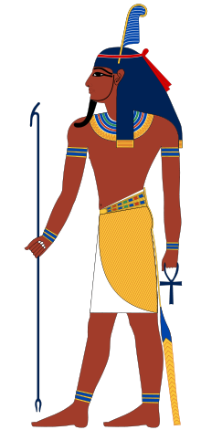
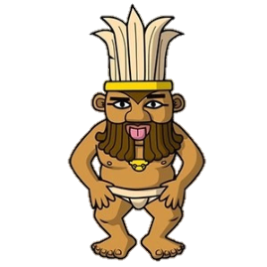
10. Who was the Ancient Egyptian god of light and air?
a.
Bes
b.
Isis
c.
Hathor
d.
Shu

Slide 12
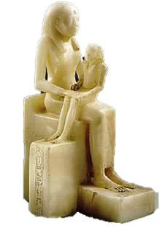
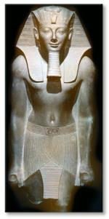
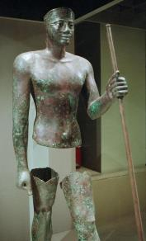
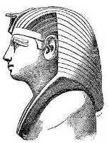
11. Pepi II is often said to be the longest-reigning monarch in history. How long was he said to be king for?
a.
64 years
b.
74 years
c.
84 years
d.
94 years

Slide 13
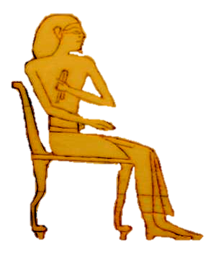
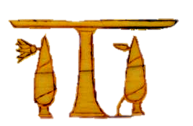
12. Name four things the Ancient Egyptians would have eaten or drank.

Slide 14

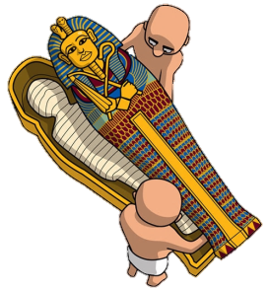
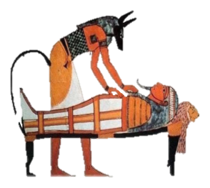
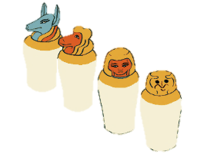
13. What was the name of the building where dead Egyptians would be mummified?
a.
The Handsome House
b.
The Pretty House
c.
The Good-looking House
d.
The Beautiful House

Slide 15
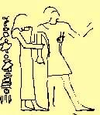
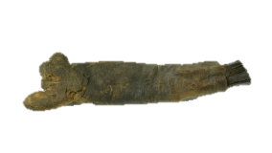

14. What is so unusual about the mummy of the woman in the Oriental Museum?
a.
Her extreme old age
b.
Her
false arm
c.
Her
name
d.
Her
job

Slide 16





15. Roughly how many bandages do you need to wrap up a mummy?
a.
Enough to cover a ping pong table
b.
Enough
to
cover
your classroom
c.
Enough to cover a basketball court
d.
Enough to cover a football pitch

Slide 17




16. What were mummy bandages made from?
a.
Linen
b.
Silk
c.
Papyrus
d.
Toilet paper

Slide 18




17. Why do Ancient Egyptian mummies have death masks?
a.
So the person’s family can recognise the body
b.
To remind people what the person looked like
c.
So the person’s
soul can recognise the body
d.
To look scary

Slide 19



18. What type of test did someone’s soul have to pass to get into the afterlife?
a.
Write an essay
b.
Answer some questions honestly
c.
Run very quickly
d.
Stand perfectly still

Slide 20




19. What happened if you failed the test to get into the afterlife?
a.
You
got
shouted
at
b.
You had to wander
the earth forever as a ghost
c.
You were fed to a hippo-crocodile monster and made to wander the land of Duat forever
d.
Your heart was fed to a hippo-crocodile monster and you were made to wander the land of Duat
forever

Slide 21








20. Which organ goes in which jar?
a. Lungs
b. Liver
c. Stomach
d. Intestines
Qebhusenuef
(the falcon)
Imsety
(the human)
Hapi
(the baboon)
Duametef
(the jackal)

Slide 22

Answers!
Ready?

Slide 23
1. What was a shabti figure?
a.
A
soldier
for the afterlife
b.
A
servant
for the afterlife
c.
A
scribe
for the afterlife
d.
A
king
for the afterlife

Slide 24

b. A servant for the afterlife.
- these figures are often holding farming or carpentry tools, and are covered in hieroglyphic writing. There is usually a magic spell to make the figure come to life in the afterlife to do their owner’s bidding. Some of the earliest pharaohs left orders that their slaves and servants be killed upon their own death, so that they could continue serving their king in the afterlife. This stops after the First Dynasty (c. 3100-2900 BCE) however.

Slide 25
2. What is the name of the jar that organs would be preserved in during mummification?
a.
Body
jar
b.
Round
jar
c.
Canopic jar
d.
Anubis
jar

Slide 26

c. Canopic jar
- these are a much better way of preserving a body, as it’s easier to dry out the organs separately rather than leave them inside. The name seems to originate from a mistaken link to the town of Canopus in Egypt.

Slide 27
3. The ‘wedjat’ eye symbol is said to be the eye of which god?
a.
Osiris
b.
Seth
c.
Thoth
d.
Horus

Slide 28

d. Horus
- although in some versions, it’s the eye of Ra as well. According to one legend, Horus loses his eye fighting his uncle Seth for the throne of Egypt but wins , having his eye restored afterwards by Thoth. Hence, Horus’ eye became a symbol of good winning over evil, safety, healing and security, while also being able to ward off the ‘evil eye’.

Slide 29
4. Why was dark blue jewellery so expensive in Ancient Egypt?
a.
It was made from lapis lazuli, which came from far outside Egypt
b.
It was made from a rock that was too hard to carve
c.
It was made from lots of crushed up beetles
d.
It was made from plants from far outside Egypt
X

Slide 30


a. It was made from lapis lazuli, which came from far outside Egypt.
- north eastern Afghanistan, to be precise, which remains today the largest source of lapis lazuli in the world. The distance from there to Egypt is just over 3,000 miles! The most famous use of lapis lazuli in Ancient Egypt is probably the blue used in Tutankhamun’s death mask.

Slide 31
5. Name the animals that the goddess of mothers and babies, Tarawet, was made up of
(three answers)

Slide 32



Crocodile, lion and
hippo
– three of the most dangerous animals
the Egyptians could
think of, the idea being
that they would be
good at keeping mothers and
babies safe.

Slide 33
6. Why was becoming a scribe so hard?
a.
It was very expensive to learn how to write
b.
Scribal school
was very tough
c.
There were over 1,000 different hieroglyphic symbols to learn
d.
All of the above

Slide 34

d. All of the above.
- the scribal school was both expensive and tough, and usually only the sons of scribes would become scribes themselves. It seems girls were not taught how to read and write – however, there is evidence of female doctors, and as doctors had to be able to read, it makes sense that at least some women could read and write in Ancient Egypt.

Slide 35
7. Why did the Ancient Egyptians often put scarab beetle amulets with mummies?
a.
They looked pretty
b.
They would keep the mummified person safe
c.
They would eat up all of the dung in the afterlife
d.
They would eat up any intruders in the tomb

Slide 36


b. They would help keep the mummified person safe
- scarab beetles were associated with the sun, because of the way that real beetles would roll balls of dung. As the sun was believed to die each day at dusk and be reborn every morning, they became a useful amulet for getting into the afterlife. They also helped care for the mummy’s heart.

Slide 37
8. What poisonous ingredient could be found in Ancient Egyptian eye makeup?
a.
Lead
b.
Arsenic
c.
Mercury
d.
Plutonium

Slide 38

Lead
– because of the minerals ground up to make eye-liner, this makeup would contain lead, which can gradually build up inside the human body, causing a wide range of symptoms including, but not limited to, headaches, kidney pain and failure, muscle weakness, insomnia, hallucinations, coma and, in extreme cases, death.

Slide 39

9. What was a cartouche?
a.
A
pen
b.
A weapon
c.
A
circle to keep your name safe
d.
A
make up pot

Slide 40



c. A circle to
keep your name safe
- usually used with royal names. In Ancient Egypt, a person’s name held great power, allowing them to be remembered and to exist in the afterlife forever. As such, a protective circle was added to keep them safe. The name comes from French soldiers who invaded Egypt under Napoleon, and thought that these shapes looked like their rifle cartridges, or ‘cartouches’.

Slide 41
10. Who was the Ancient Egyptian god of light and air?
a.
Bes
b.
Isis
c.
Hathor
d.
Shu

Slide 42




d. Shu
- as god of light and air , he held the goddess of the sky, Nut, apart from Geb, the god of the earth. It seems that if he didn’t do this, there would be no way for the entire physical world to exist.

Slide 43
11. Pepi II is often said to be the longest-reigning monarch is history. How long was he said to be king for?
a.
64 years
b.
74 years
c.
84 years
d.
94 years

Slide 44

d. 94 years!
- BUT this may be wrong. He became pharaoh at the age of six, and certainly reigned for at least 64 years, so maybe, 64 years can also be the correct answer. Ultimately, we can’t know for sure either way.

Slide 45
12. Name four things the Ancient Egyptians would have eaten or drank.

Slide 46


There is a whole range of food and drink that the Egyptians would have been familiar with, including
Bread (the main food for most Egyptians)
Fruit (including pomegranates, dates, grapes and
plums)
Meats (including beef, mutton, goat, fish, duck,
goose, crane and heron)
Vegetables (including onions, leeks, cabbages,
radishes and turnips)
Drinks – beer, wine, milk, water (though this was
often polluted)

Slide 47

13. What was the name of the building where dead Egyptians would be mummified?
a.
The Handsome House
b.
The Pretty House
c.
The Good-looking House
d.
The Beautiful House

Slide 48

d. The Beautiful House
- or wabet to give it its Egyptian name, which can also mean ‘the clean place’. Again, it doesn’t really fit, considering what went on there.

Slide 49
14. What is so unusual about the mummy of the woman in the Oriental Museum?
a.
Her extreme old age
b.
Her
false arm
c.
Her
name
d.
Her
job

Slide 50

b. Her false arm
- this is what makes her really unusual today. Very few mummies from Egypt have false limbs, and our mummy is one of the earliest. What’s more, the false arm was made for her when she was mummified, not when she was alive. Her age, 50-60 years old, would have been old for ancient Egypt, but not unusually so. We know that she worked as a priestess in a temple, keeping the gods happy, and as for her name – we don’t know, as the paint on that part of her sarcophagus has been destroyed.

Slide 51

15. Roughly how many bandages do you need to wrap up a mummy?
a.
Enough to cover a ping pong table
b.
Enough
to
cover
your classroom
c.
Enough to cover a basketball court
d.
Enough to cover a football pitch

Slide 52











c. Enough to cover a basketball court
- or about 4,000 square feet of material. This was normally supplied by the dead person’s family, and was often recycled from old clothes or other things.

Slide 53
16. What were mummy bandages made from?
a.
Linen
b.
Silk
c.
Papyrus
d.
Toilet paper

Slide 54

a. Linen
- commonly used for clothes,
blankets and so on,
so there was
always plenty of it
around
to wrap mummies
up in.

Slide 55

17. Why do Ancient Egyptian mummies have death masks?
a.
So the person’s family can recognise the body
b.
To remind people what the person looked like
c.
So the person’s
soul can recognise the body
d.
To look scary

Slide 56

c. So the person’s soul could recognise the body
- the Egyptians believed that after death, a person’s soul, or ‘ba’, flew over the tomb and drew energy from it. The way a ‘ba’ would recognise its tomb and body was, of course, with a death mask. Bear in mind though, that any spots, blemishes or scars wouldn’t make it on to the death mask!

Slide 57
18. What type of test did someone’s soul have to pass to get into the afterlife?
a.
Write an essay
b.
Answer some questions honestly
c.
Run very quickly
d.
Stand perfectly still

Slide 58

b. Answer some questions honestly
living a good, honest life was
always a good idea as well if you
wanted to pass the test.

Slide 59
19. What happened if you failed the test to get into the afterlife?
a.
You
got
shouted
at
b.
You had to wander
the earth forever as a ghost
c.
You were fed to a hippo-crocodile monster and made to wander the land of Duat forever
d.
Your heart was fed to a hippo-crocodile monster and you were made to wander the land of Duat
forever

Slide 60

d. Your heart was fed to a hippo-crocodile monster and you were made to wander the land of Duat forever
- only the heart, as without this, you could not get into the afterlife, but your soul would wander lost, always searching for a body it would never find. In some versions, with the loss
of the heart, you would
simply cease to
exist
at all.

Slide 61
20. Which organ goes in which jar?
a. Lungs
b. Liver
c. Stomach
d. Intestines
Qebhusenuef
(the falcon)
Imsety
(the human)
Hapi
(the baboon)
Duametef
(the jackal)

Slide 62

a.
Lungs
Hapi
(the baboon)

Slide 63

b.
Liver
Imsety
(the human)

Slide 64
c.
Stomach
Duametef
(the jackal)

Slide 65

d.
Intestines
Qebhusenuef
(the falcon)

Slide 66

Tie breaker question!
What language do the words ‘hieroglyph’, ‘pharaoh’, ‘pyramid’, and ‘Egypt’ come from?

Slide 67

Tie breaker answer!
Ancient Greek!
Much of what we know about the Egyptians comes from Greek writings, and of course the Greeks ruled Egypt for nearly 300 years, giving Greek names to many things and places.

Slide 68
Well done,
explorers!

