Slide 1
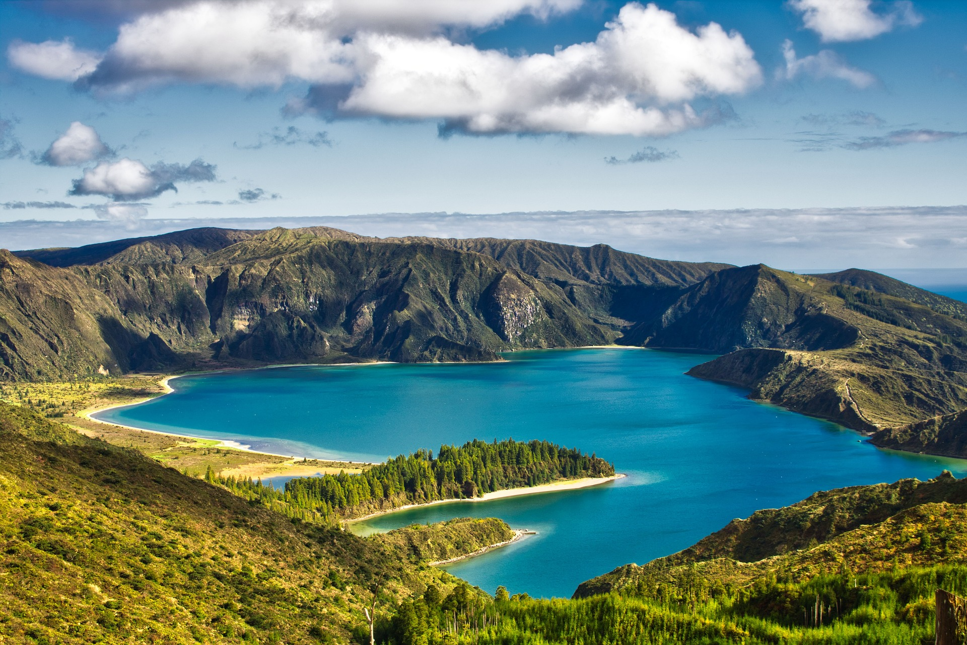
The Research Culture Island
Creative Workshop
Designed by the Research Culture Team at Durham University – Facilitator Overview
Please contact Andrew Moss, a.d.moss@durham.ac.uk for more information about the sessions

Slide 2
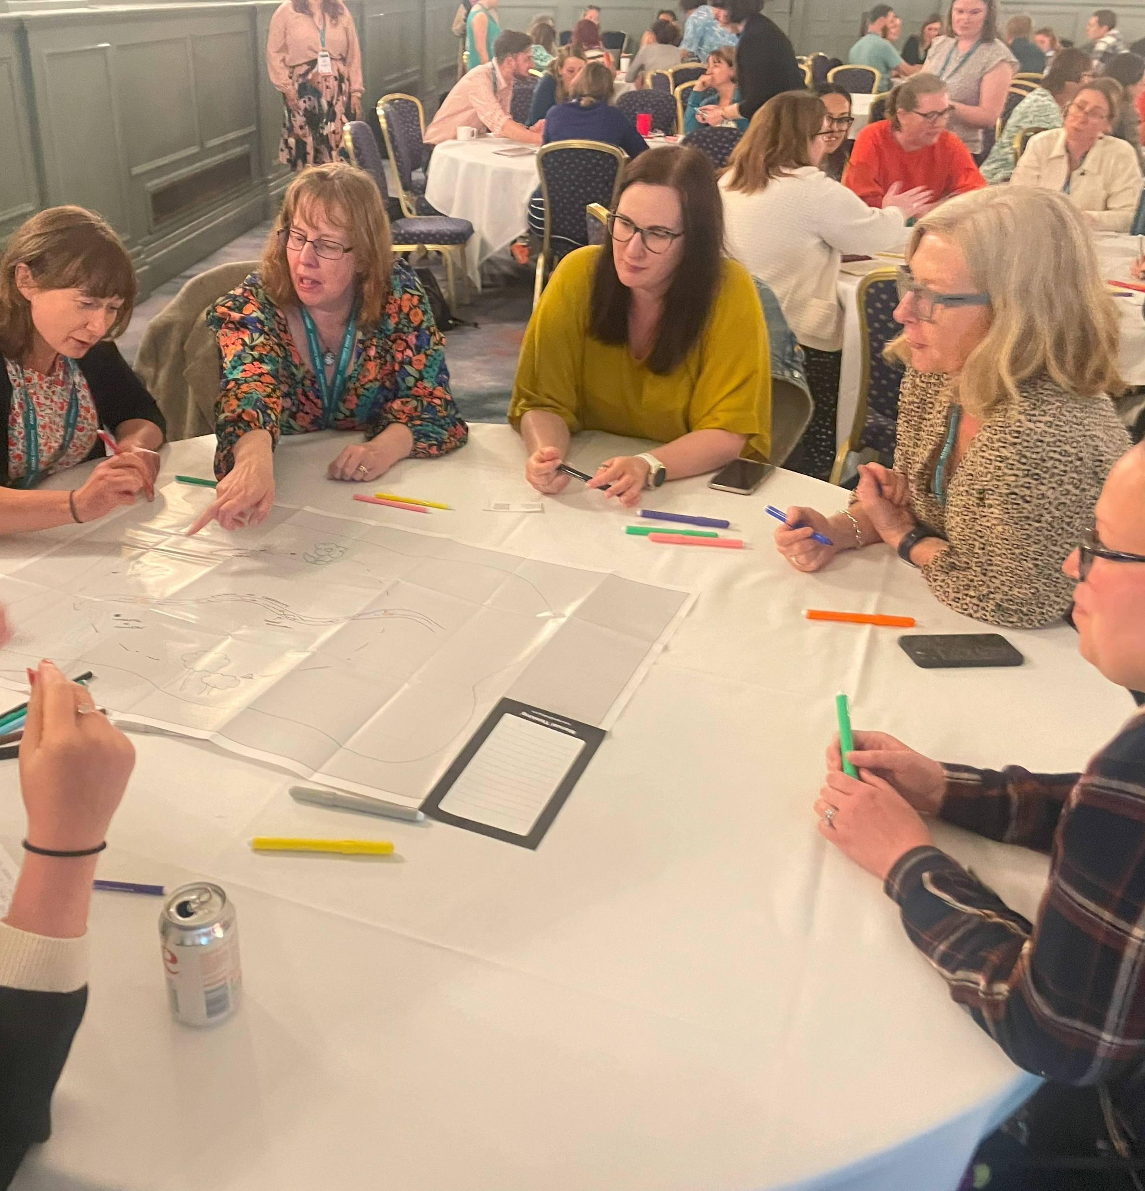
Research Culture Islands – About
‘Research Culture Islands’ is a creative workshop designed to explore through metaphor how we create a healthy research culture ecosystem. The aim of the session is to encourage participants to explore the research culture landscape and express some of the challenges and opportunities in a creative and safe environment.
The resource was created by the Research Culture Team at Durham University, alongside the Creative Facilitation Team in the Institute for Medical Humanities at Durham University.
This is a free resource for HEIs, research professionals and administrators to use in different contexts and teams. It has been used with colleagues at different careers stages and across the research environment with academics and professional services staff.
Please let us know if you use the resource and acknowledge the team that created the resource in your session. We’re also really happy to guide you through how the session might be developed so please get in touch. Please send us any feedback about how we might improve it to Andrew Moss, Research Culture Manager, Durham University: research.culture@durham.ac.uk

Slide 3
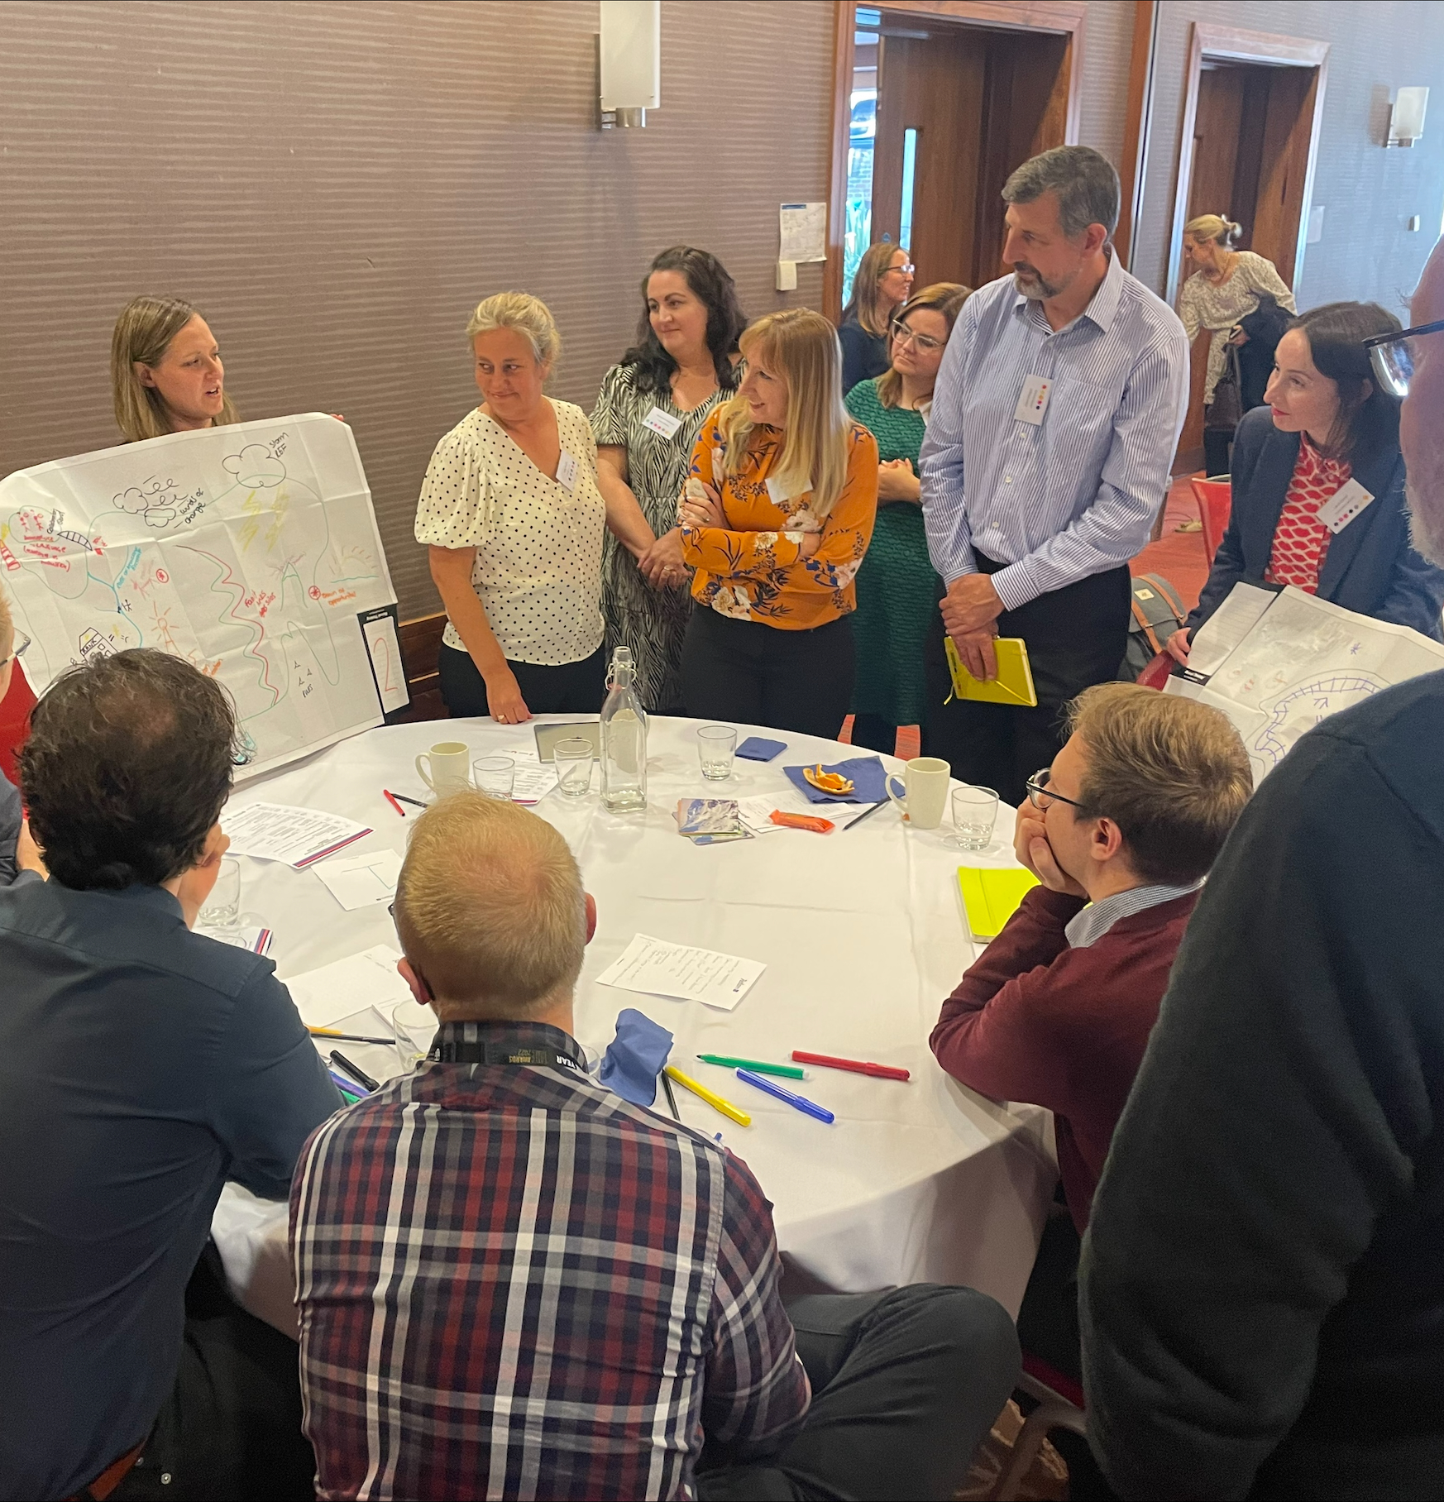
For Facilitators
Resource Overview
For facilitators, the workshop offers new avenues, correlations and challenges about developing a positive research culture.
The maps provide insight into commonalities across groups which might not be expressed through a Q&A discussion. These could feed into research culture strategies and project delivery and also enable further consultation on specific themes.
The tool offers an evaluation method around common research culture themes and is seen as a stepping stone to research culture developments and actions

Slide 4
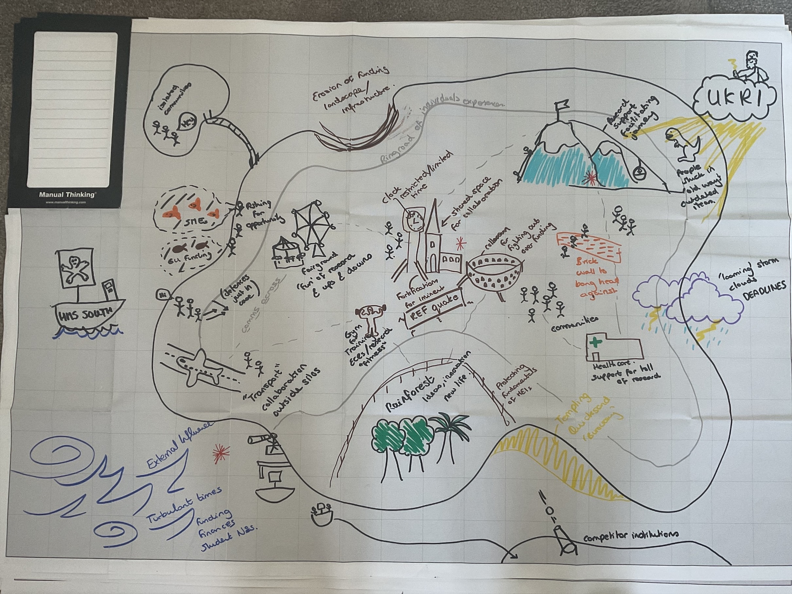
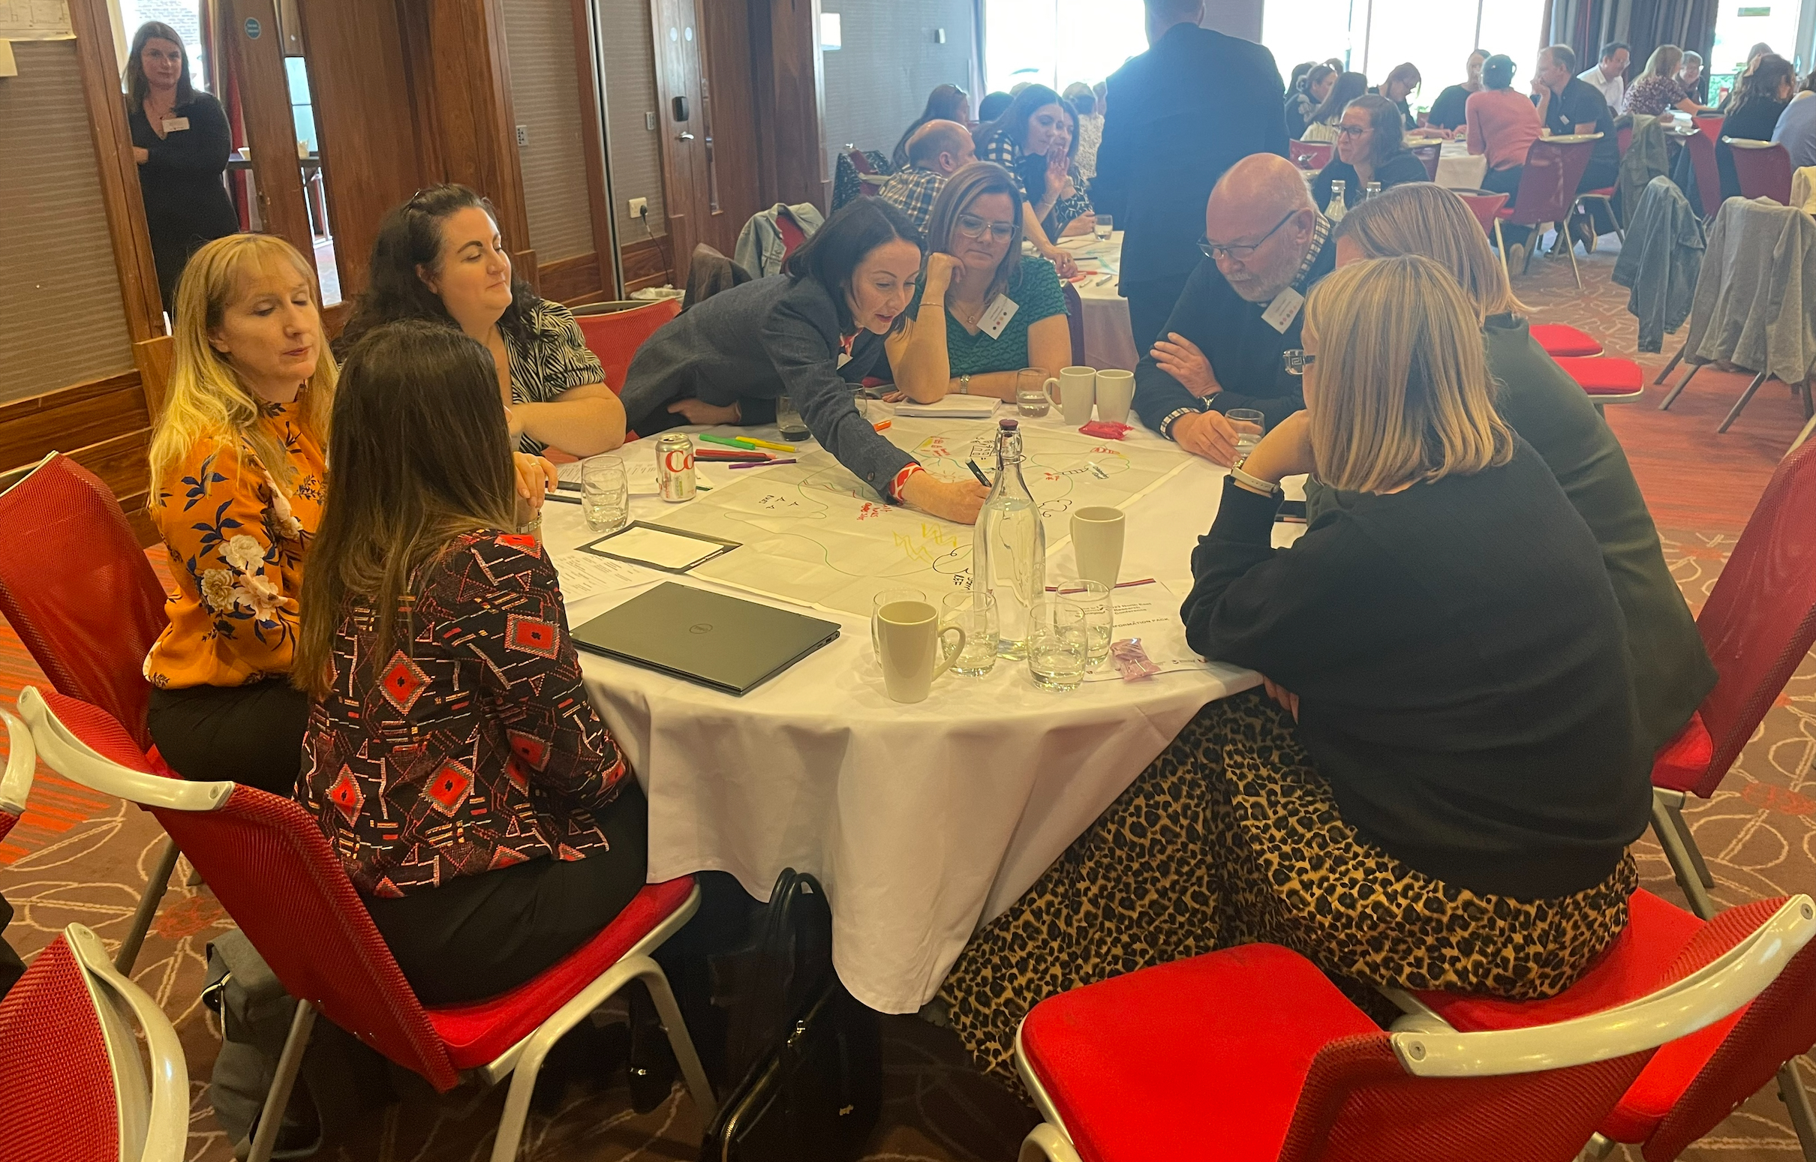
For Facilitators
Resources and Materials
Materials
PowerPoint slides detailing the activity (Slides 1, 5-9)
Large Maps - Available Here: Maps Large - Manual Thinking - Tools for co-creation
Good quality colouring pens
Optional: Island stickers / other creative materials
Resource Time
Islands works well within a 1-hour timeslot
  15min setup and explanation with aims
  30min creative activity
  15min feedback loop
The workshop requires at least one lead facilitator but works well with 2-3 facilitators to encourage discussion and to seek commonalities across the maps to highlight.
Resource Space
Islands works best in a collaborative space with roundtables with plenty of space for interaction.
It is best enabled with groups of 4 or more participants per map and works best with 20+ participants and can be upscaled effectively.
For the feedback loop, encourage 2 tables to merge for collaboration and discussion.

Slide 5
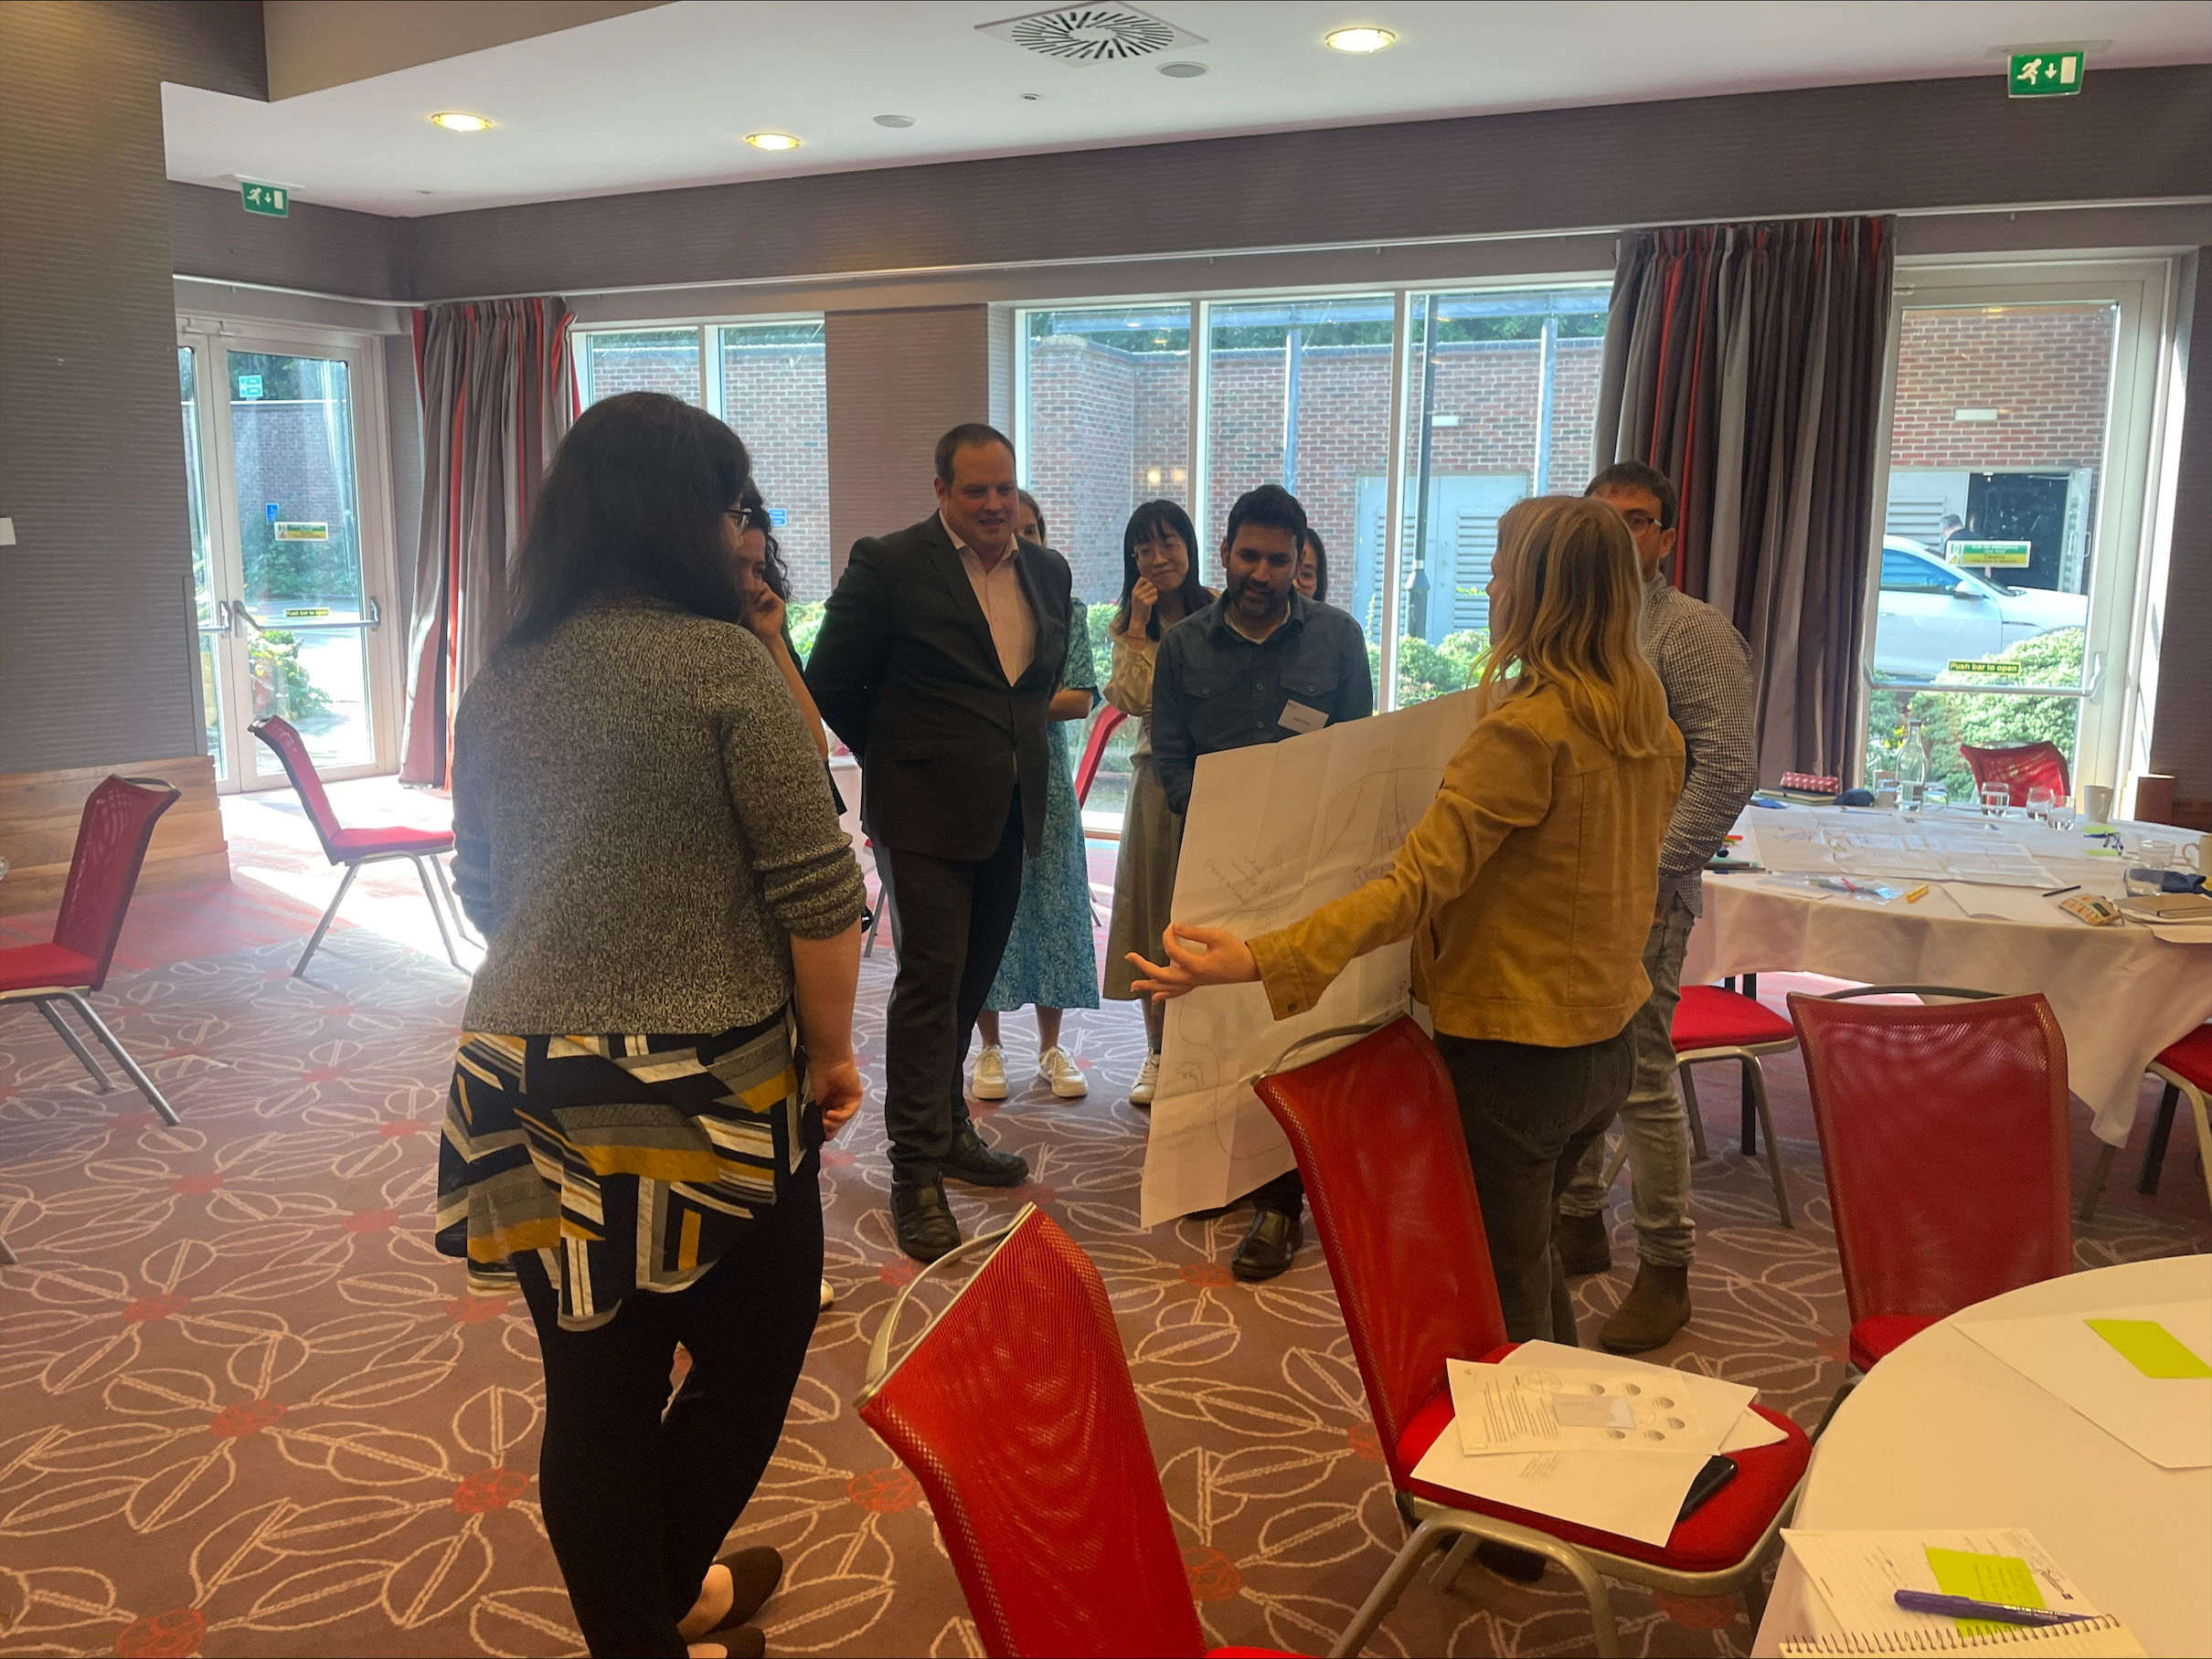
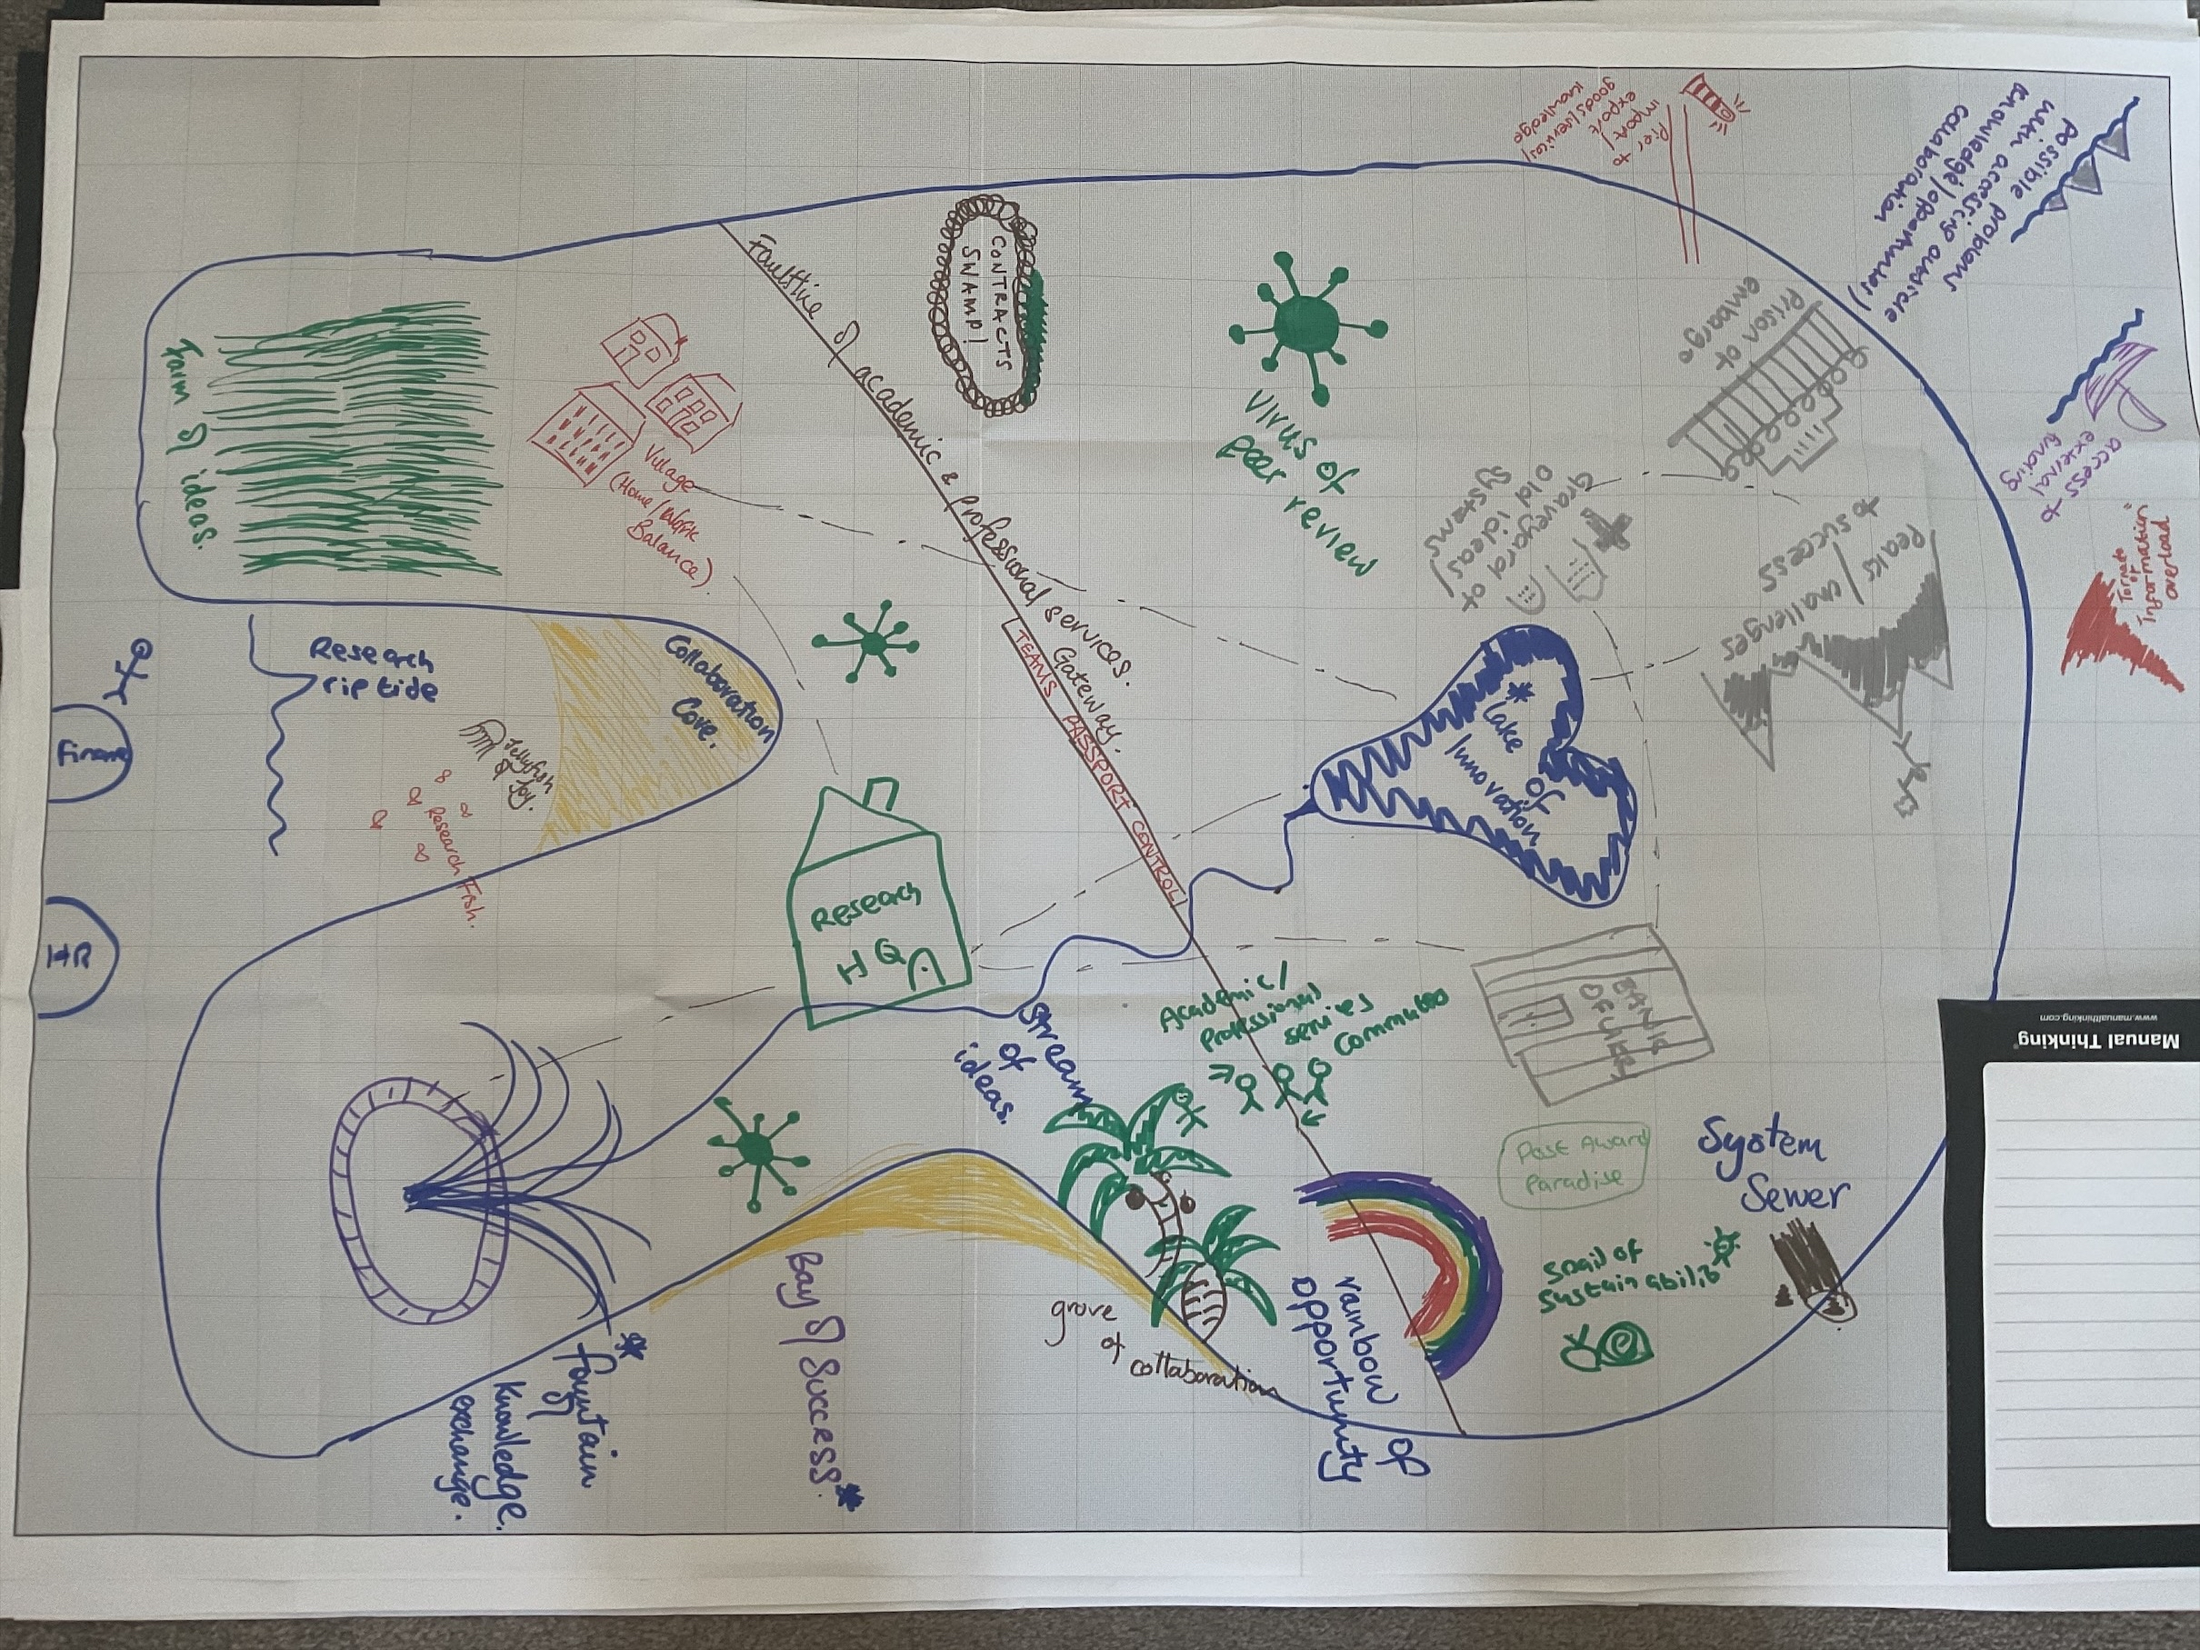
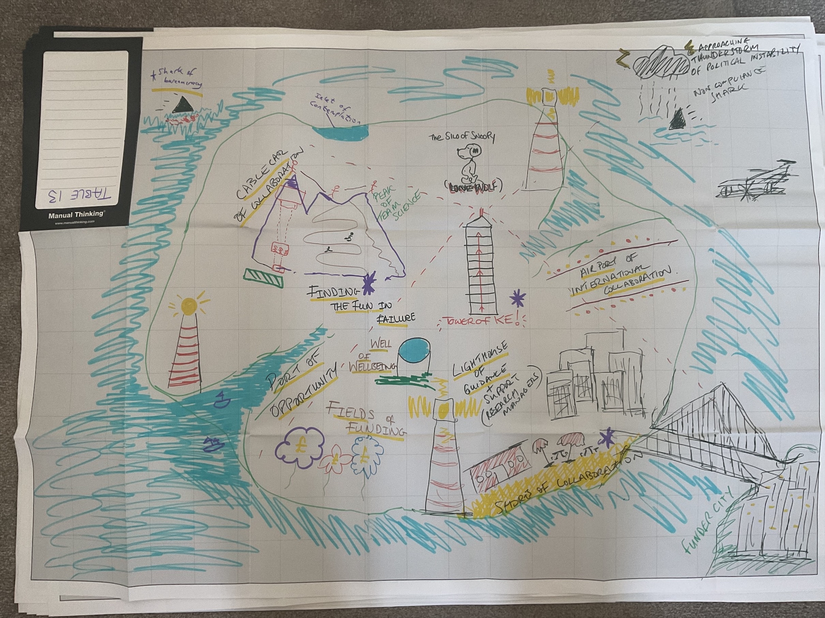
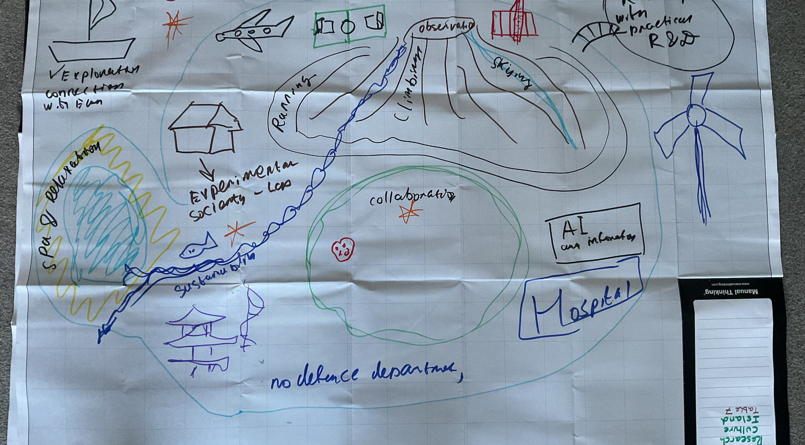
For Facilitators
Outcomes
Encourages collaboration and conversation between participants
Develops networking and discussion
Encourages positive debate and dialogue
Enables positive evaluation of research culture
Communicates and explores challenges in a new way

Slide 6
Aims
To explore how a healthy research culture ecosystem and environment flourishes.
To draw and illustrate how it is constructed and sustained by creating a metaphorical island
To evaluate through geographic and poetic language the strengths and threats to the island.
To consider what actions can be taken to enable a positive research culture

Slide 7
Method
Each table has a large map and pens
In 30 minutes:
Draw an outline of an island
Then add your symbols and label the places, features and surroundings that create your research culture island.
The islands don’t have to be perfect, just pick up a pen, discuss and create!

Slide 8
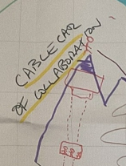
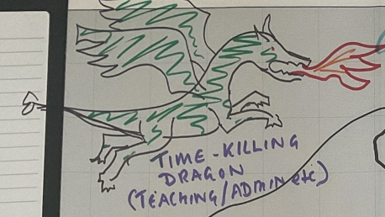
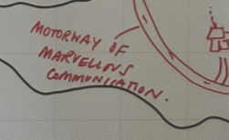
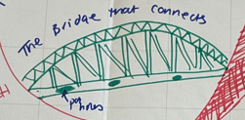
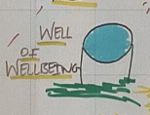
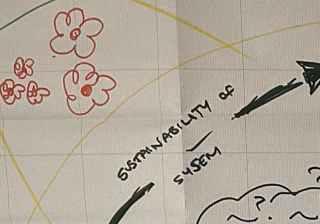
Places to add and explore
Landmarks
What are the key places on the island — what makes the island flourish?
Bedrock
What is the island created from, does it have fault lines running through it?
Community
What are the most populous places and where are the opportunities for new communities?
Peaks
What is the highest point and what are the challenges to get there?
Borders
Are there challenges of getting on and off the island? Are there bridges or barriers?
Travel
How do people get around the island, are there people just helicoptering in?
Sustainability
What flowers and thrives on the island, how does it keep itself healthy?
Threats
Are there stormy waters that surround the island or whirlpools that stop people getting to there? Are there any swamps of despair?

Slide 9
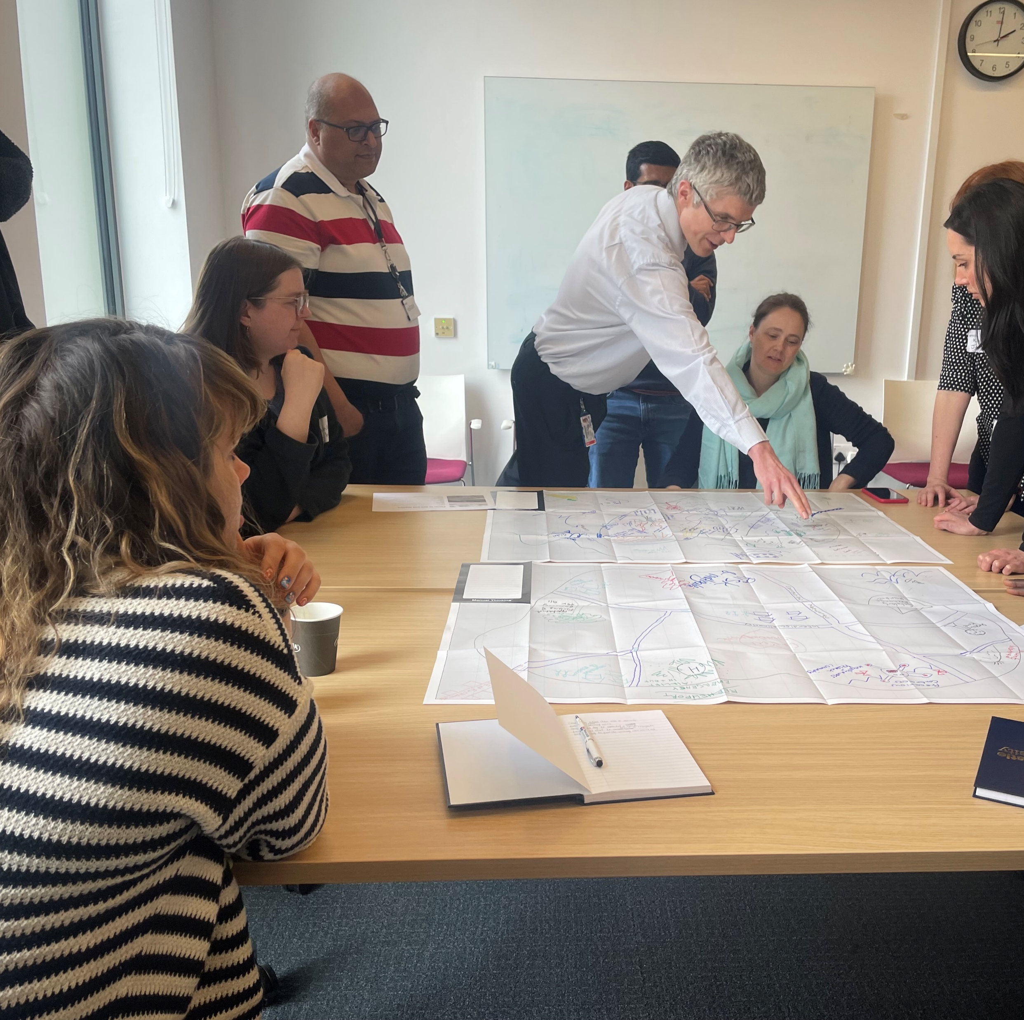
Feedback Loop 1
Mark with an asterisk the top three aspects of your island. Then swap with the table opposite.
Consider how we might go about creating the island and what opportunities would need to be explored to build the thriving ecosystem.
What actions could you take to create a more effective research culture ecosystem?

Slide 10

Feedback Loop 2
As a group, we’re going to consider how we might go about creating the island and what opportunities would need to be explored to build the thriving ecosystem.
What actions could you take to create a more effective research culture ecosystem?
What opportunities are there for developing a positive research culture?

Slide 11
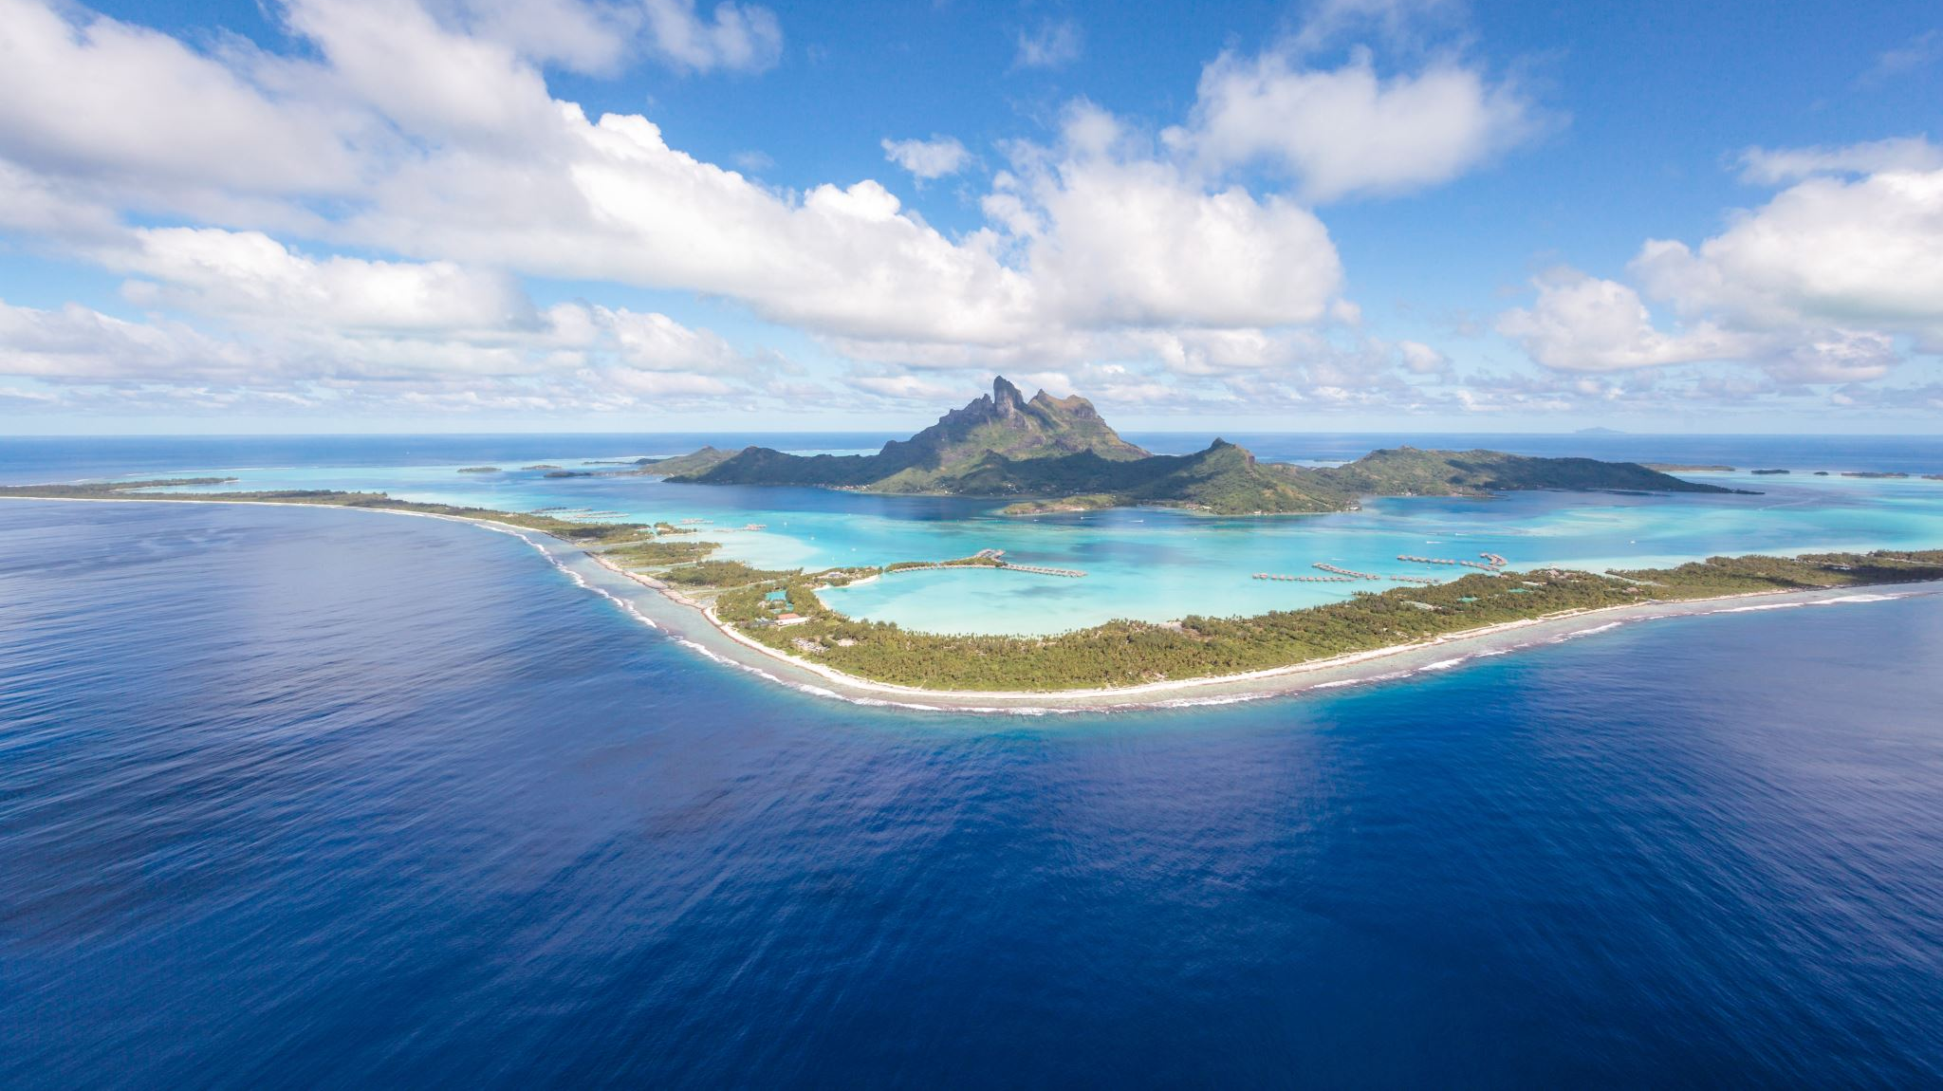
Some Examples of Islands Created

Slide 12
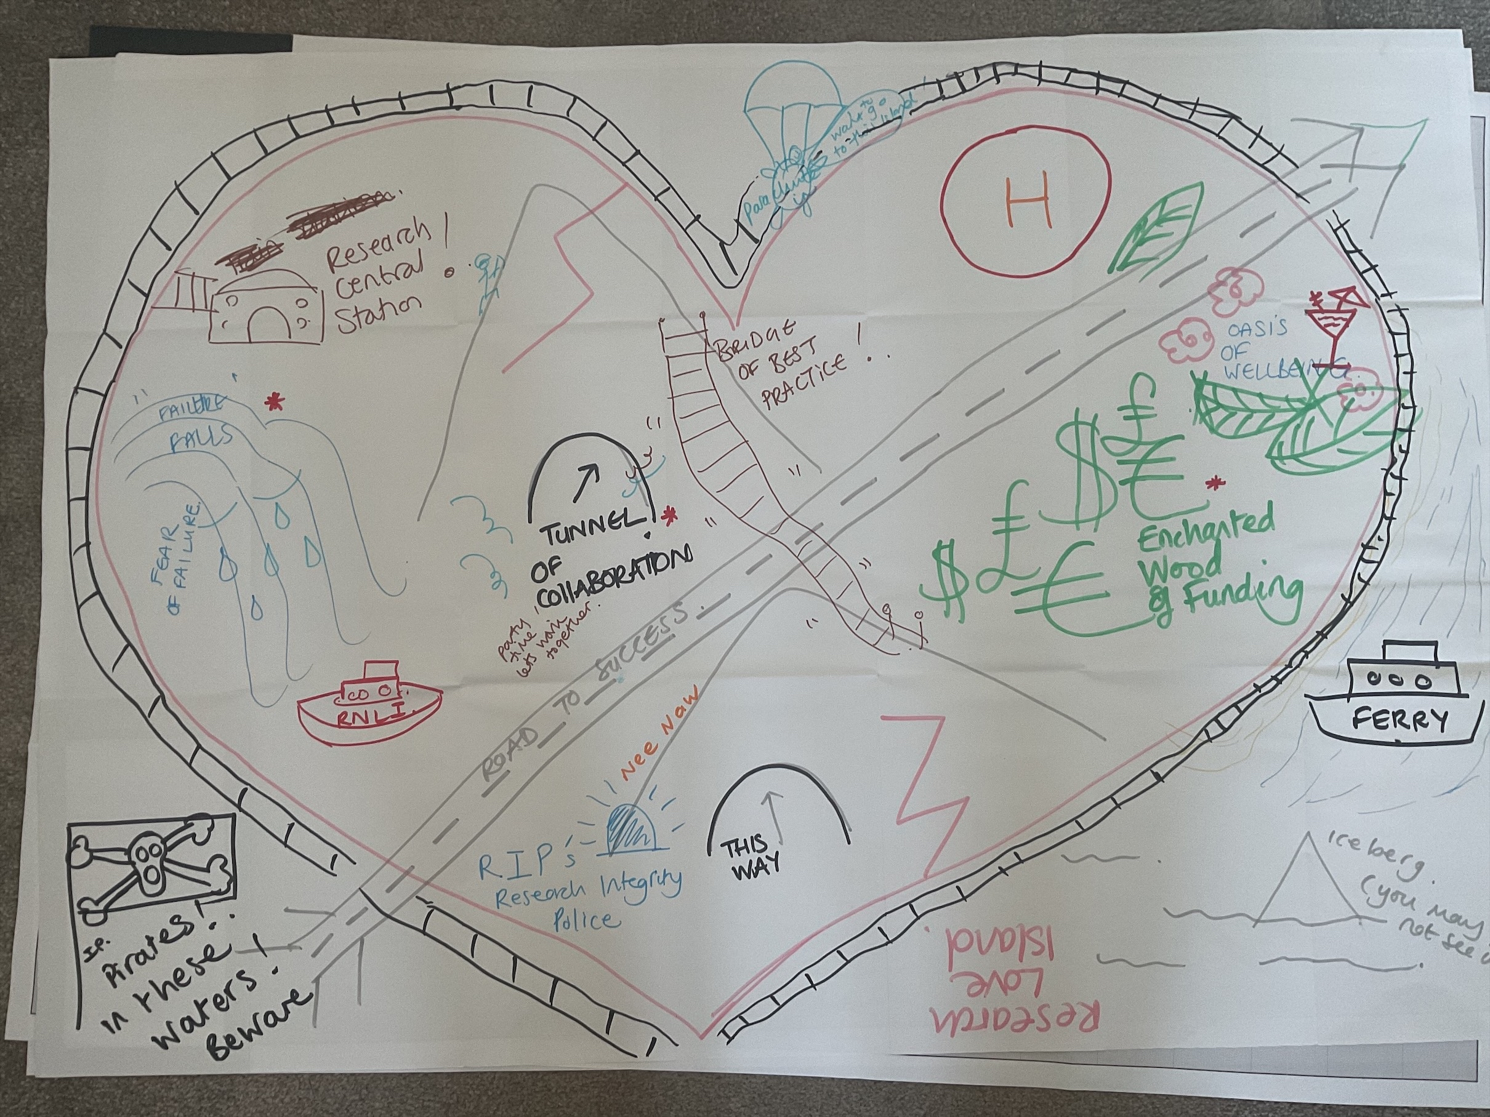

Slide 13
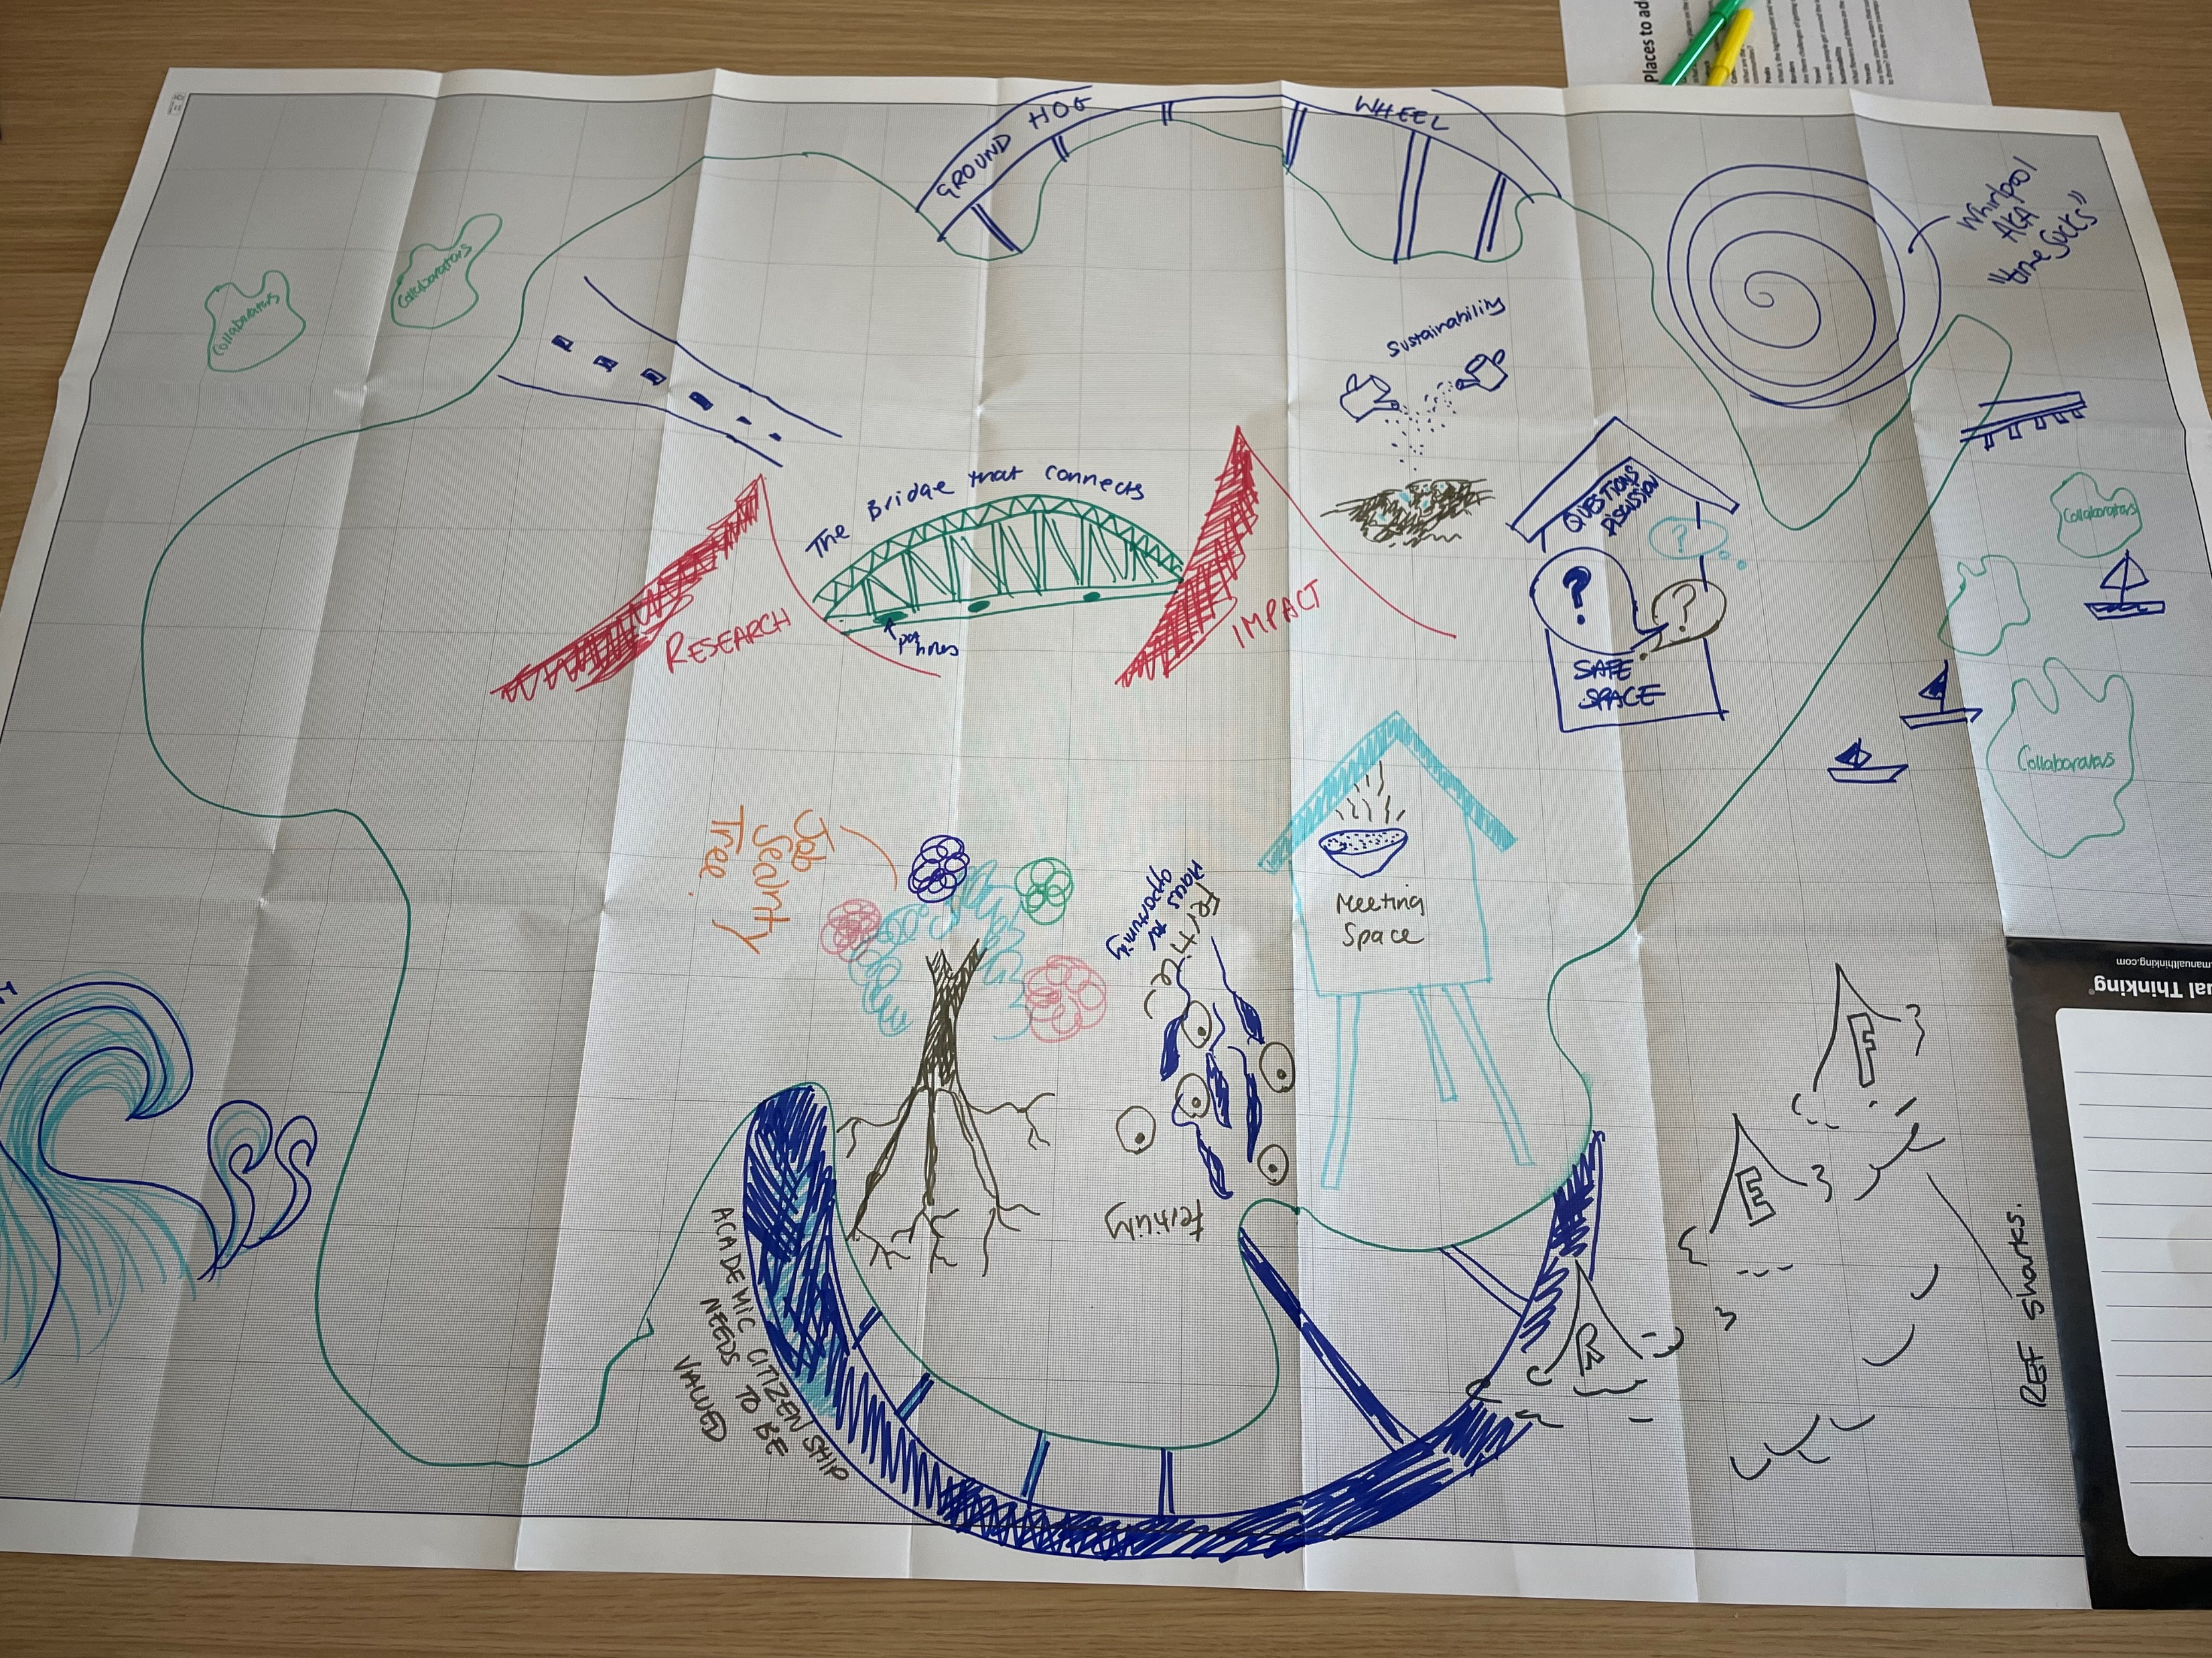

Slide 16
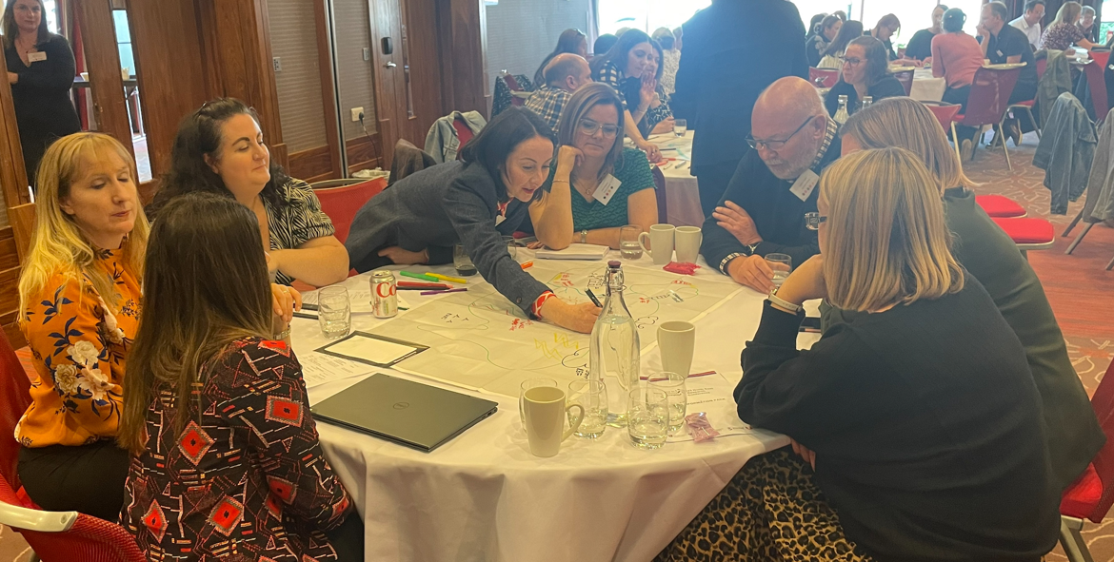
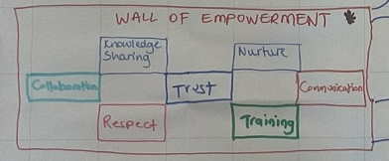
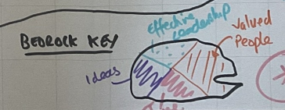
Evaluation – Examples
Opportunities
Collaboration
Wellbeing
Knowledge Exchange
Harmony of working practices
Fulfilled roles
Challenges
Bureaucracy
Silos
Funding Landscape
How to improve the relationship between academic and PSS
REF

Slide 17
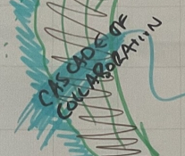
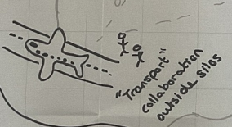
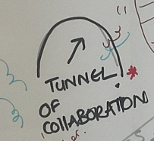
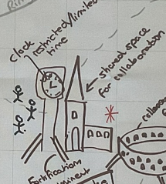
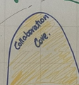
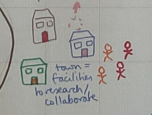
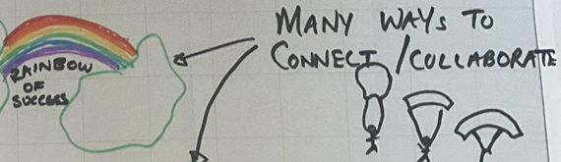
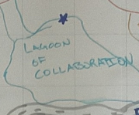

Evaluation Theme: Collaboration

Slide 18
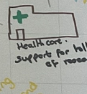
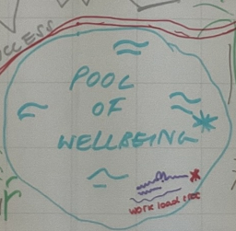
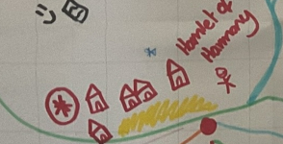
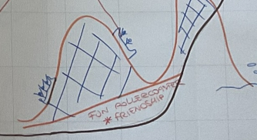
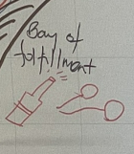
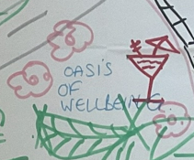
Evaluation Theme: Wellbeing

Slide 19
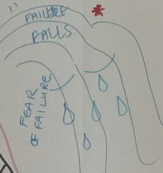
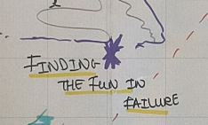
Evaluation Theme: Fear of Failure

Slide 20
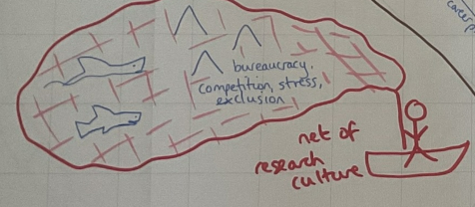
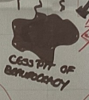
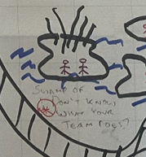
Evaluation Theme: Bureaucracy

Slide 21
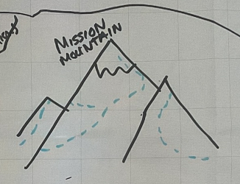
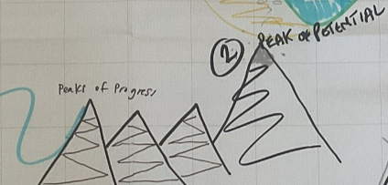
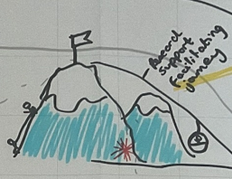
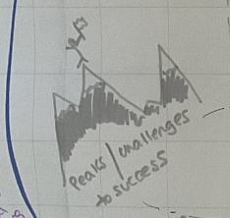
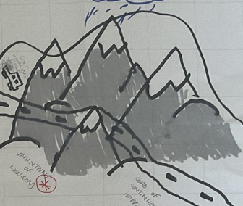
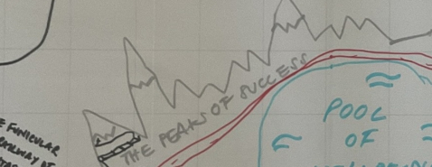
Evaluation Theme: Peaks

Slide 22
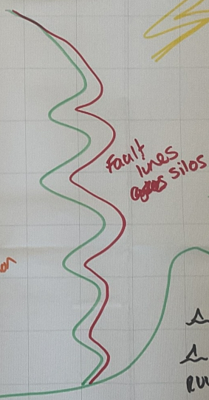
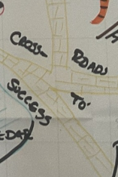
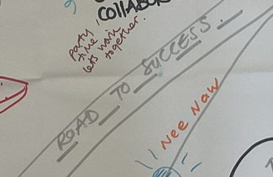





Evaluation Theme: Landscape and Infrastructure

Slide 23







Evaluation Theme: Singular Themes

