Slide 1

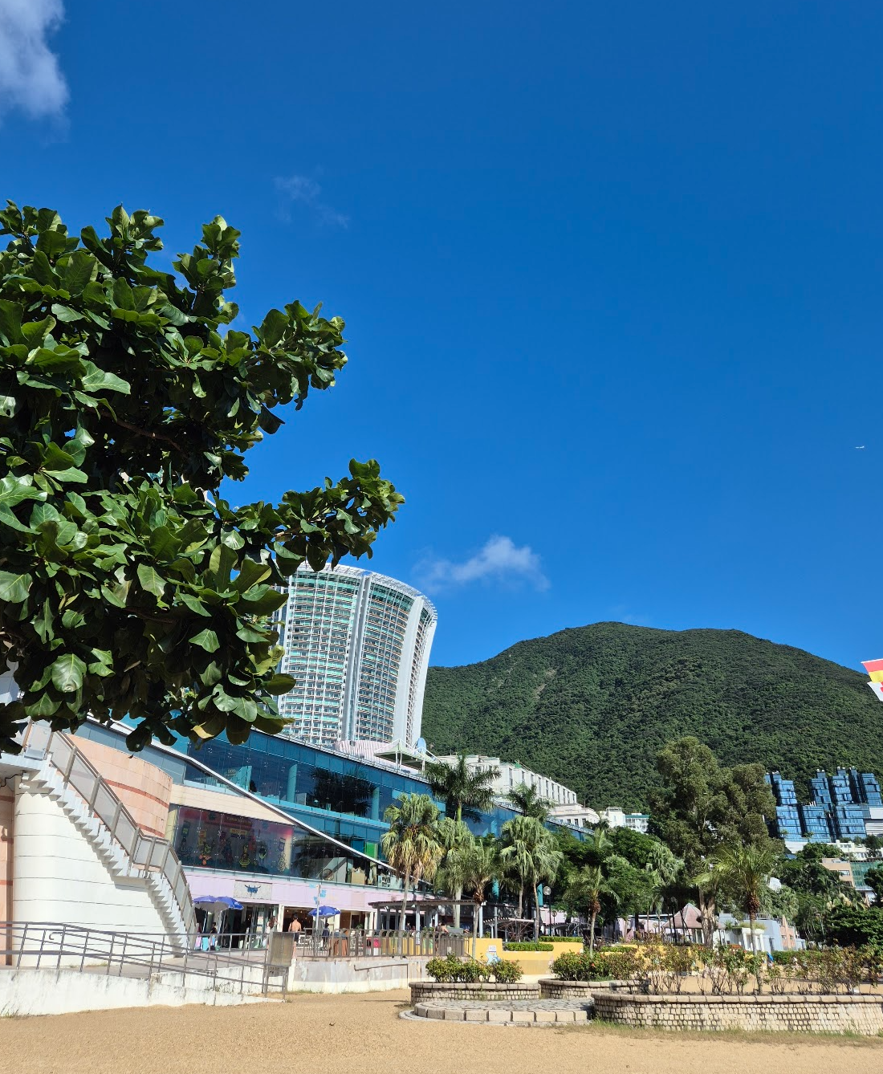


Study Abroad in Hong Kong!
My experience studying at HKU! Jozef Prywata

Slide 2

What Do You Want From Your Year Abroad?

Slide 3


Choosing a University::
Top Two: HKU (Hong Kong) and NUS (Singapore)
Consider:
Location
Accommodation
Modules
Which courses and locations are right for you?

Slide 4
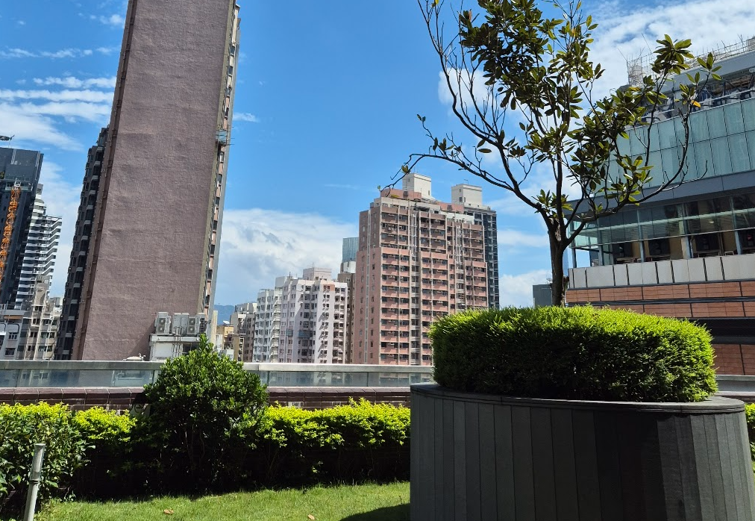

The University of Hong Kong:
2 Campuses in one!
Over 10 Canteens / Restaurants!
The Common Core!
Vibrant student community!

Slide 5


Clubs & Societies:
Early student fair then weekly campus booths
HKUDB – Dragon Boat Club: Training and Races
Art, Calligraphy Societies!
Application before travel?

Slide 6


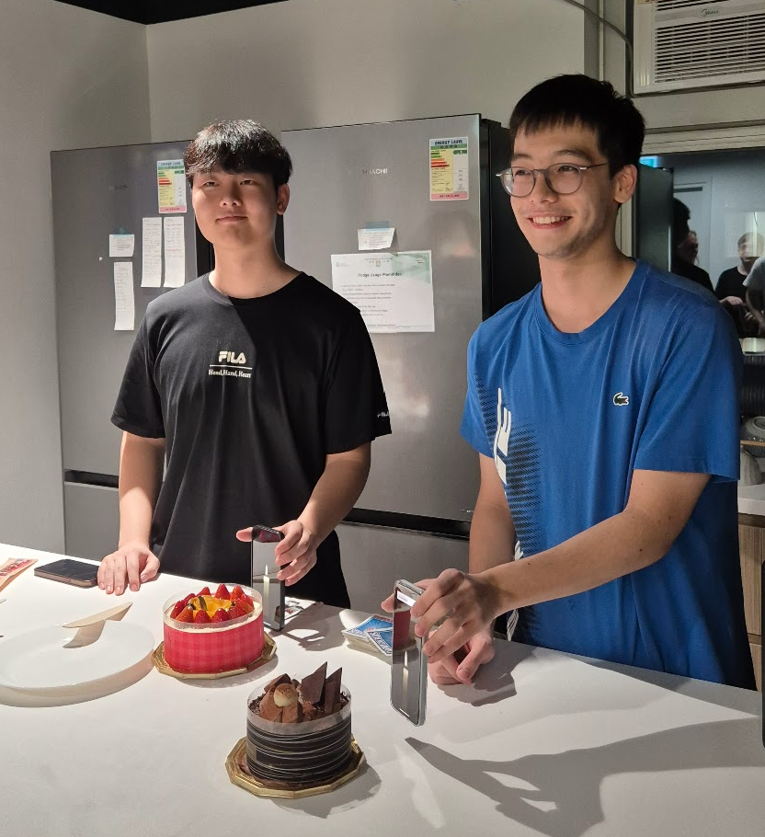
Life Abroad:
It’s Pass / Fail (at least for geography!)
Opportunities to travel & explore!
E.g. Weekly theme park trips -> and a trip to Water World!
You get out what you put in!
Supportive network of exchange students!

Slide 7
My Modules:
Urban Planning: Principles and Practices
Smartphones, K-pop and Kimchi: South Korea Beyond The Miracle
Cantonese as a Foreign Language
Urban Legends: Fact, Myth, Interpretation
Introduction to Psychology

Slide 8


Challenges:
Pre-departure process
Adjusting to heat
Finding time for myself
Making friends (local and international)

Slide 9


Personal Growth:
“ Spending time abroad really determines what is you and what is your environment”
A blank slate!
Introduction to language and culture
Leadership & Organisation
LinkedIn post inspiration!

Slide 10


In Conclusion…
Research!
Personal statement must be personal!
Anticipate and embrace new experiences
You still have support back here
Enjoy it whist it lasts - I’m already ¼ of the way through my year!

Slide 11







Thank you for Watching and Listening!
Best of luck with your year abroad application!

