Slide 1
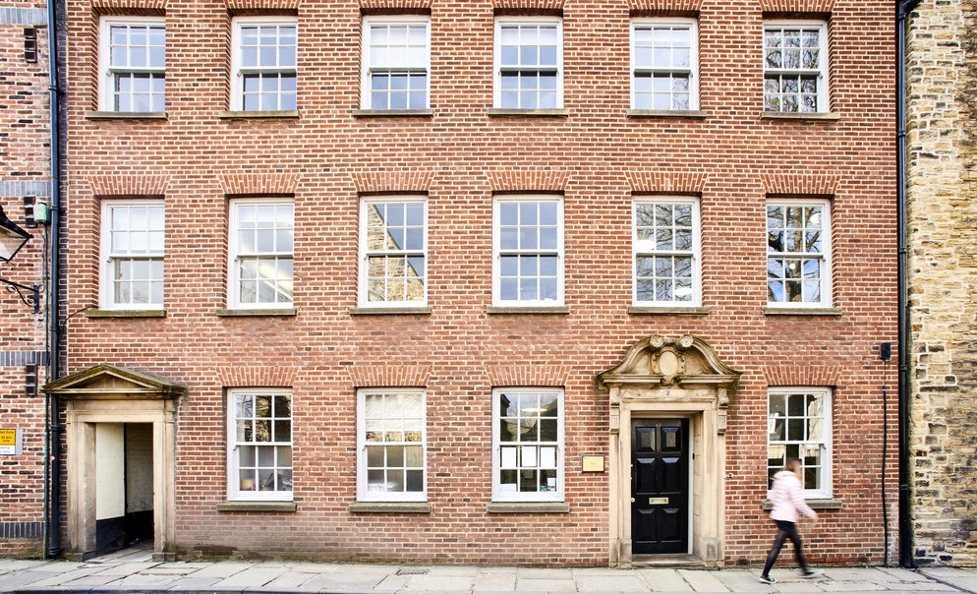
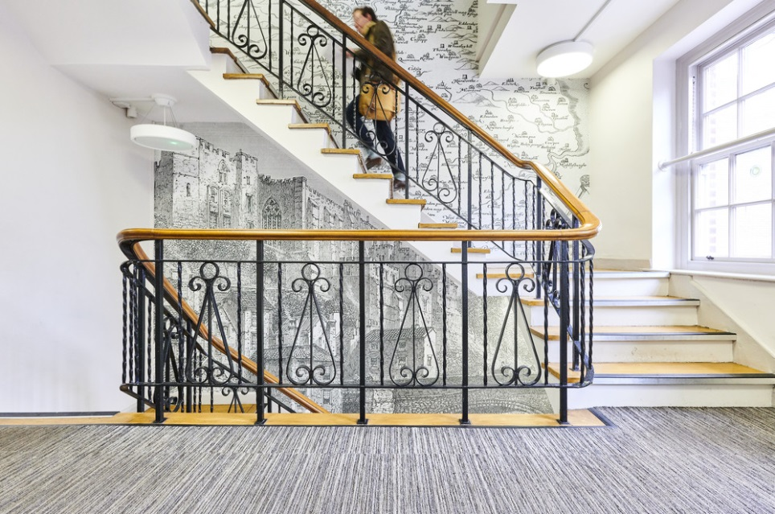
STUDYING HISTORY AT DURHAM
OPEN DAY
June 2022

Slide 2
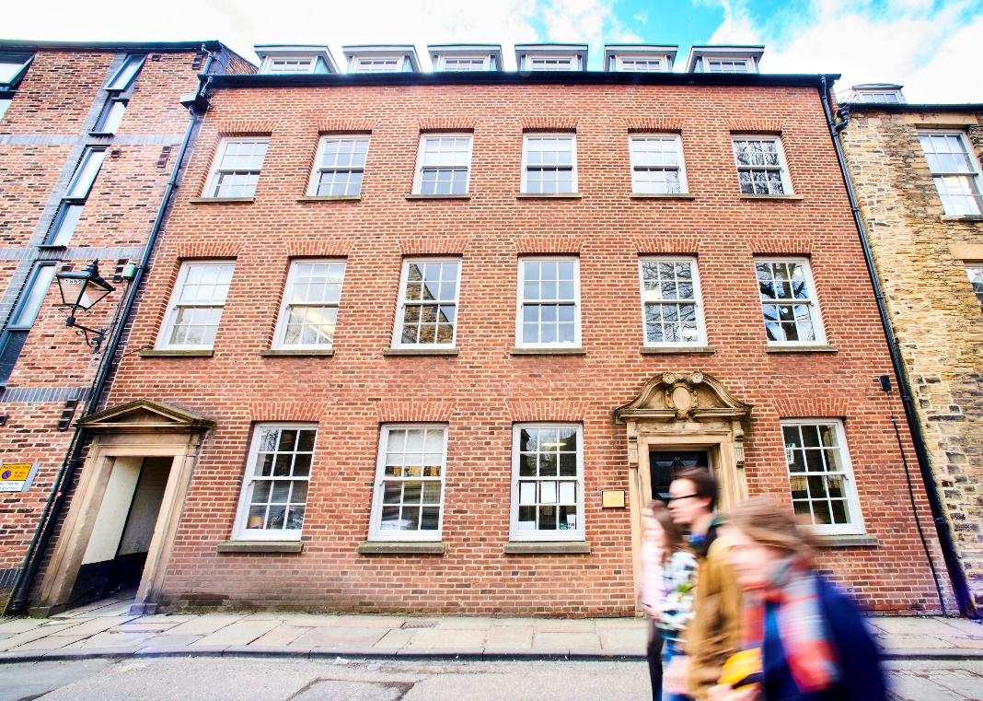
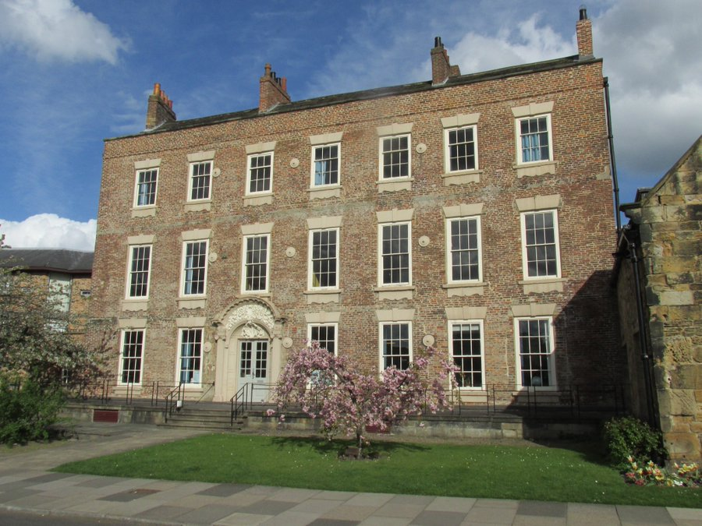
The History Department 43-46 North Bailey, Cosin’s Hall (Palace Green)

Slide 3
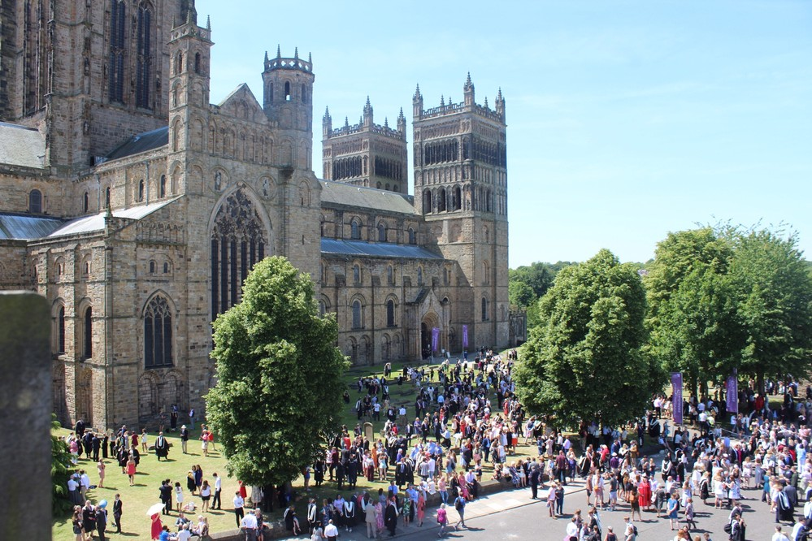
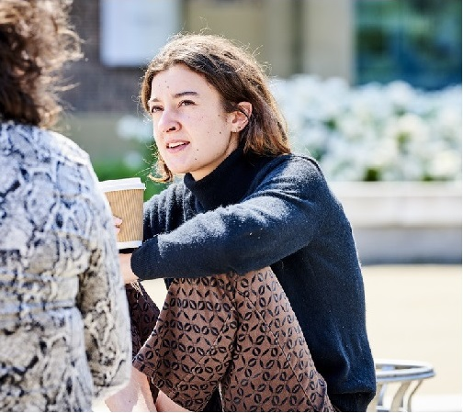
Every university offers its students something different but you have to choose which university is right for you.

Slide 4
TODAY’S SESSION
09.30-10.30 Welcome talk with Prof. Len Scales (Head of Department) and Dr Gaby Treglia (Admissions)
10.50-11.50 Sample teaching session with Prof. Graeme Small
12.10-13.10 Sample research session with Prof. Christina Riggs
13.30-14.30 Durham student experience
14.50-15.50 Roundtable Q&A

Slide 5
Single Honours First Year
1 Core Module:
Making History
(double weighted)
4 Option Modules
Making history is taught by ‘strands’
Examples from the current year include:
‘Queen Elizabeth I’
‘Boxer Rebellions and Foreign Devils in Qing China, 1900-1901’
‘Radicalism in Early Victorian Britain’
‘Europe and the Islamic World’
1 x Medieval, 1 x Early Modern, 2 x Modern Up to 2 modules in other departments
Examples from previous years include:
‘Decline and Crisis? Europe 1300-1500’
‘The Atlantic Archipelago, 1500-1750’
‘The Rise and Fall of American Slavery’
‘Power in Africa, 1800 to the present’

Slide 6
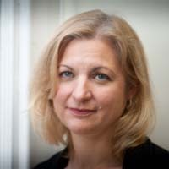
‘Making History’ Strand: American Nativism
Central paradox in US history
Centred on John Higham’s Strangers in the Land
Claims, evidence, narrative
How it was received in the
1950s, 1980s, 2010s
Looking at evidence directly

Slide 7
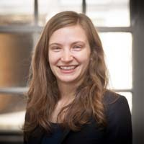
Level 1 Option Module: Power in Africa, 1800 to the present
Sub-Saharan Africa: manmade and natural disasters or human resilience and resistance?
Partition of Africa and colonial rule
Decolonization
African initiatives and responses
Sample essay questions:
Was medicine a tool of empire?
Were young Africans drawn to the city to escape the traditions of the village?

Slide 8
Single Honours Second Year
1 Core Module:
Conversations with History
(doubled weighted)
4 Option Modules
Examples from the current year include:
‘Nature and Power in East Asian History’
‘Politics and Reform in America, 1877-1914’
‘Demythologising the Weimar Republic’
‘Sport in History’
2 modules in first and second term
1 x Western European, 1 x non-Western European
Examples from previous years include:
‘Inventing France, 1300-1500’
‘Modern China’s Transformations’
‘Black British History’
‘International Human Rights since 1945’

Slide 9
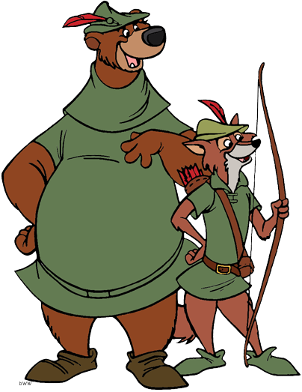
Second Year Option Modules
‘Robin Hood’
‘Lythe and listin, gentilmen,
That be of frebore blode;
I shall you tel of a gode yeman,
His name was Robyn Hode.’
Using the medieval stories of this famous outlaw to understand attitudes towards authority, kingship, crime and the Church in late medieval England

Slide 10
Single Honours Third Year
Special Subject
(triple weighted)
Dissertation
(double weighted)
Option Module
(single module)
3 hour seminar
Every week
Primary sources
Independent study
Your ideas
Your questions
Your research
Breadth of expertise for supervision
Significant historical questions and debates, e.g.:
‘Interpreting Conflict in Post-Colonial Africa’
‘Revolution and History’

Slide 11
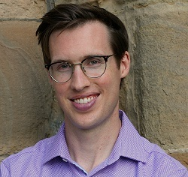
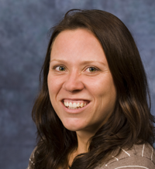
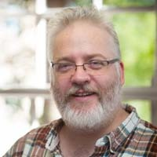
Third Year Special Subjects
The American Civil War and Reconstruction
Developing Africa
Popular Cultures in Early Modern England

Slide 12
Module Assessments
Level 1:
Making History: 20% book review; 20% source analysis; 60% project
5 Option Modules: 40% essay; 60% exam
Level 2:
Conversations with History: 20% essay; 70% project; 10% presentation
2 first-term modules: 100% essay
2 second-term modules: 100% exam
Level 3:
Special Subject: 40% exam; 20% essay; 20% essay; 20% source analysis
Single option module: 40% essay; 60% exam (seen 72hrs before)
Dissertation: 100% essay

Slide 13
The details: Joint Honours
LEVEL 1
Three modules in History
LEVEL 2 & 3 (Ancient, Medieval and Modern)
Between 5 and 7 modules in History across the 2 years
LEVEL 2 & 3 (History and English)
Minimum of 40 credits per year in each department
Between 100 and 140 credit in each department across the two years
Usually: Special subject in History OR Dissertation and Single module
For History and Modern Languages, level 3 is spent abroad, so your final year is level 4
https://www.dur.ac.uk/history/undergraduate/courses/

Slide 14
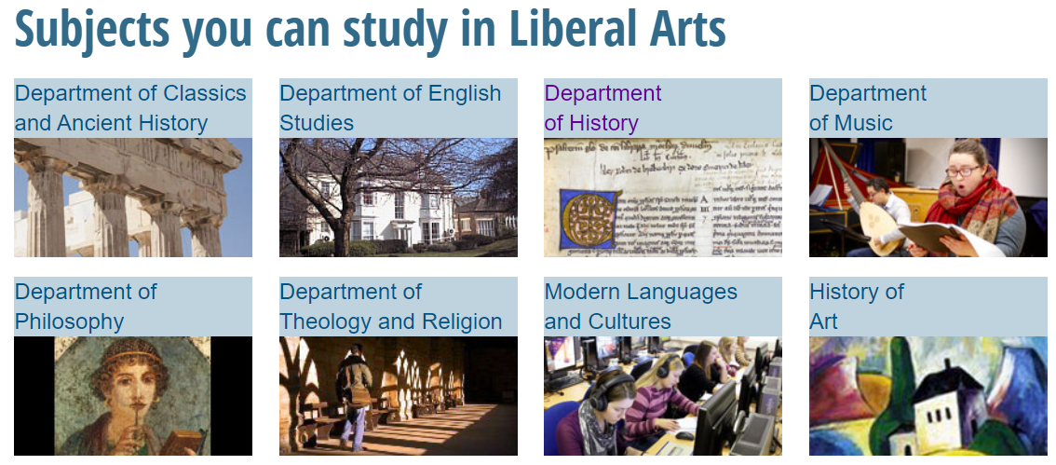
Combined Honours in the Arts/Liberal Arts
LEVEL 1
Up to three modules in History
LEVEL 2
Up to four modules in History
LEVEL 3
Up to 80 credits
in History
https://www.dur.ac.uk/liberal.arts/

Slide 15
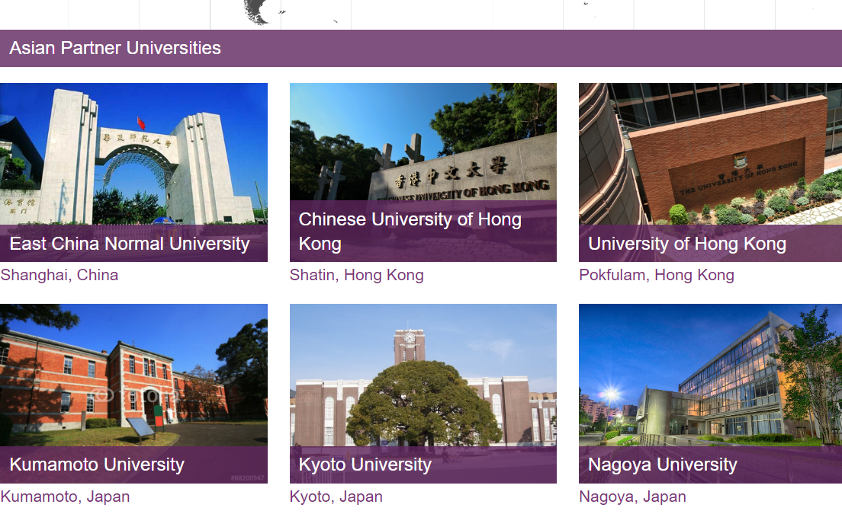
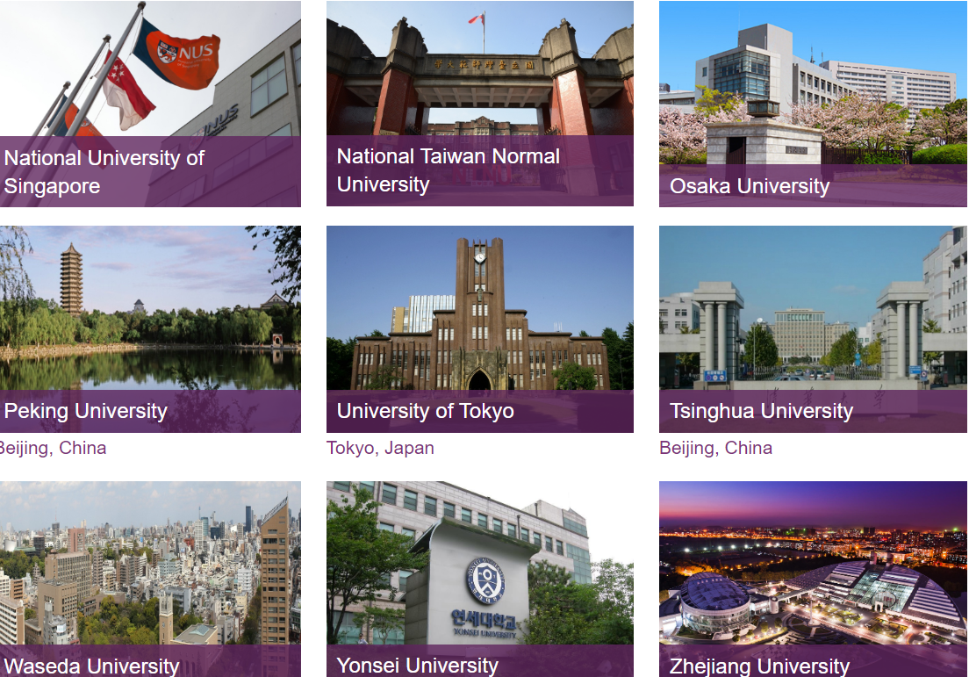
Placement Year/ Year Abroad
In 2019-20, students could take a placement year between years 2 and 3
40 weeks paid work experience – did not have to be history related
A wide range of international partners with options to study abroad

Slide 16
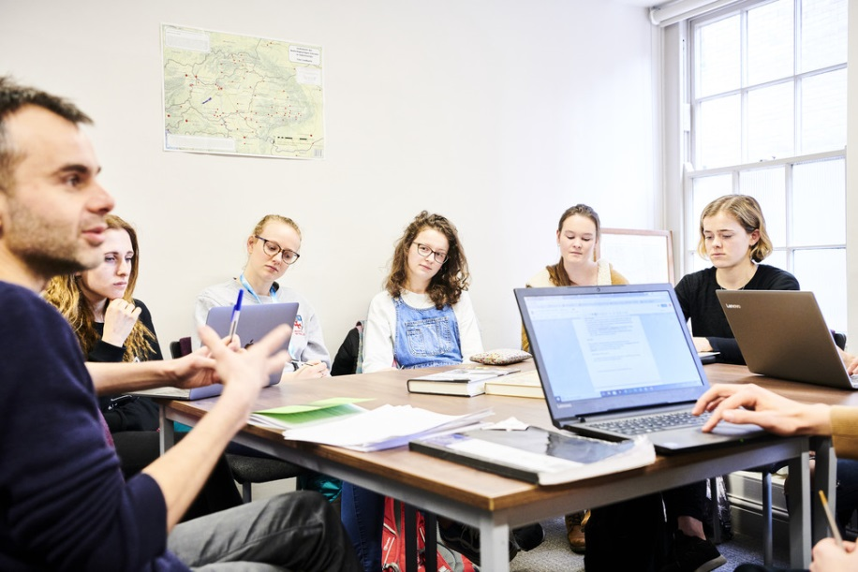
Research-Led Teaching
Taught by world experts in the field
Importance of breadth and depth to students’ education
Most importantly, you learn through doing actual research
‘Making History’
‘Conversations with History’
‘Special Subject’
‘Dissertation’

Slide 17
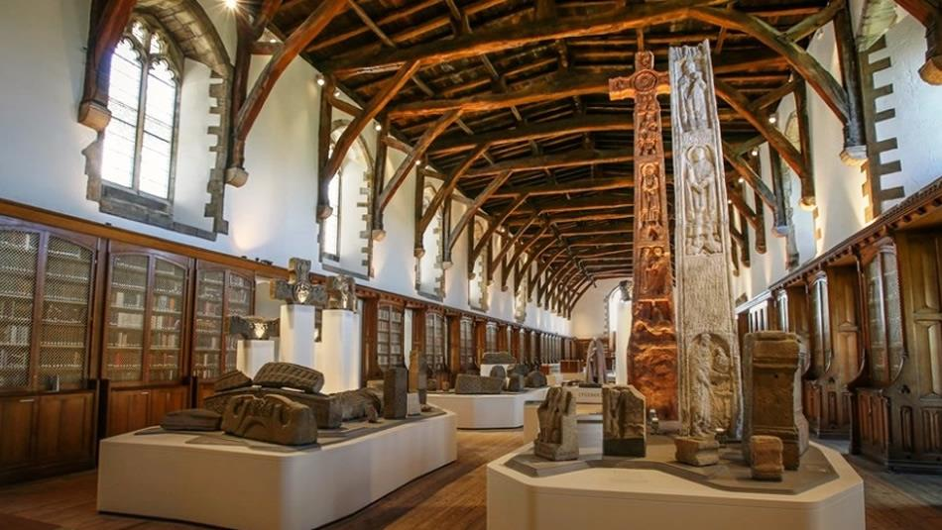
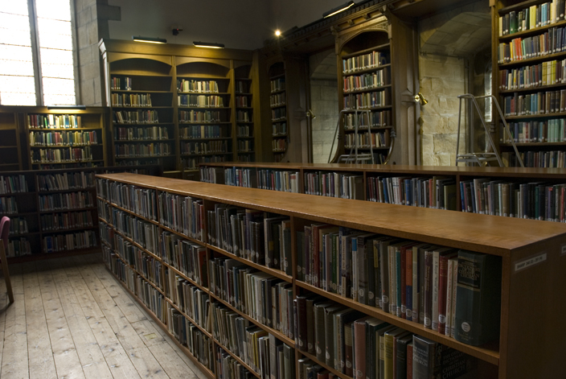

Slide 18
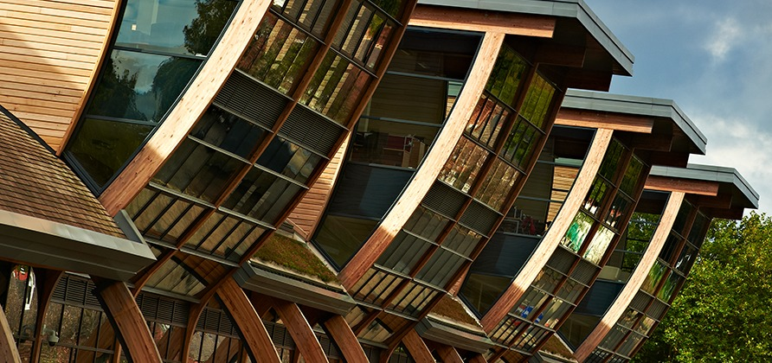
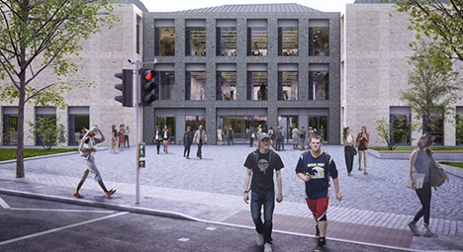
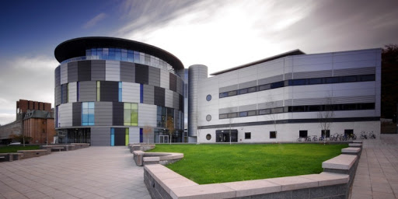

Slide 19
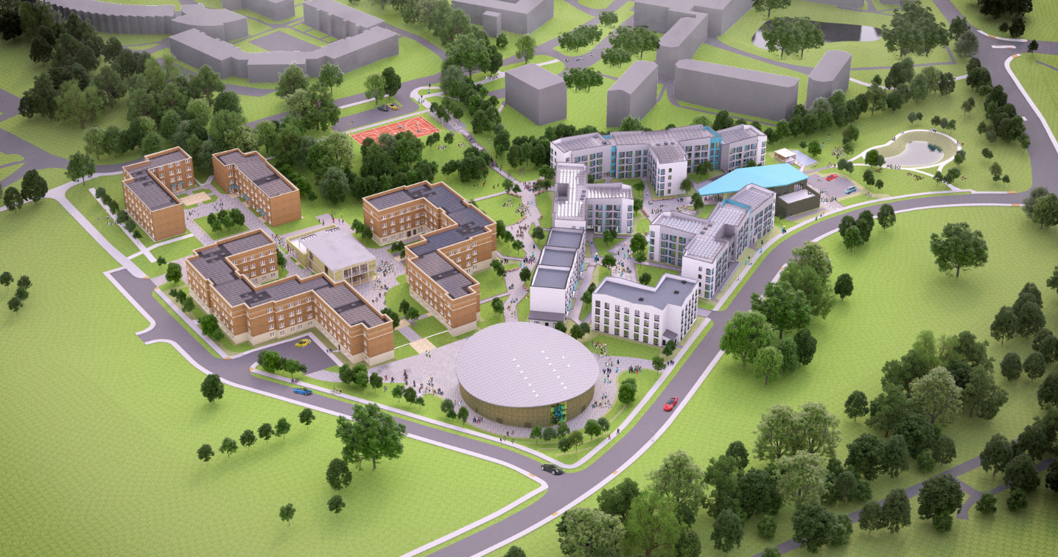
Seventeen distinct colleges

Slide 20
Breadth and depth: diversity of options and ability to specialise
Progression and independence: developing your ideas and your identity

Slide 21


History at Durham University: Admissions

Slide 22
Employability History at Durham: diverse range of careers
Transferable skills:
Independence
Identification of sources/information
Interpretation of sources/divergent opinions: critical evaluation of information
Formation and defence of arguments
Communication: written arguments; structuring an argument/report; oral presentations

Slide 23
History: 'Standard offer'
A level offer: A*AA (inc. History)
Cambridge Pre-U: D2D3D3 (inc. History)
BTEC Level 3 National Extended Diploma/OCR Cambridge Technical Extended Diploma: D*DD and History A level at grade A (or equivalent) is required
IB Diploma score: 38 with 666 at Higher Level (inc. History)
For other qualifications and deferred entry queries use the AskUs form:
https://www.durham.ac.uk/study/courses/v100/#entry-requirements-927478

Slide 24
History: Assessment of Applications
Applications via UCAS
Our approach to assessment of applications is 'holistic' - we consider the following:
Evidence of attainment (results and predictions)
Personal statement
Reference
Timing: we often wait until UCAS equal consideration deadline to get a sense of the strength of the cohort
this means many offers granted in February and March
don't be discouraged if you don't hear from us immediately

Slide 25
Personal Statements: What are we looking for?
Personal statement - avoid templates!
Don't just list historians/books
Show enthusiasm, commitment, potential for:
Independence of thought: what you think about the past; who you agree with and why
Critical engagement: why do you agree/disagree with a particular approach? Why do you want to study a specific field in greater depth? Etc.

